Slide 1


LearnZilla Web Portal
A Project Report
Submitted By:
Name of the Student (University Roll No)
Vivek Singh = 1819084
Rohit Kumar = 1819078
Gaurav Chaudhary = 1819075
in partial fulfillment for the award of the degree
of
BACHELOR OF TECHNOLOGY
IN
COMPUTER SCIENCE AND ENGINEERING
I. K. GUJRAL PUNJAB TECHNICAL UNIVERSITY, MOHALI CAMPUS 1
C-102/B PHASE 7 INDUSTRIAL AREA SAS NAGAR MOHALI, PUNJAB (INDIA) - 160055
MONTH & YEAR

Slide 2
Outline
LearnZilla is an educational portal, In which we have tried to put educational content that is useful to students at one place.
Scope of LearnZilla
To present and avail educational videos.
To make different web pages for different subjects.
To include previous year question papers or test papers.
To direct viewer to other web sites.
Overview of LearnZilla
We have created a portal from scratch that is capable of showing educational videos and drafts.
We are capable of adding new subjects along with their videos and papers.
This portal will provide each user with a profile and password, with our easy layout user can watch all our available content.

Slide 3
Timeline to achieve objective:
Month | Progress
March | Selecting Topic Getting familiar with Technology
April | Making webpages Creating hyperlinks and UI
May | Finalizing project in second week of MAY

Slide 4
Introduction and Motivation
Importance and need of project
The Problem You are Solving
Distraction - Generally social platforms are full of unnecessary stuff which delays productivity.
Information stored in the database, which provides data security.
In YouTube their are many tutors and courses so user may distract to other courses leaving an unfinished course behind.
Free of cost – The user will not have to pay anything to browse through our portal
No complex user interface – The UI is easy to use and to the point.
No tracking of data – We have not added any cookies to track any data from the user
No privacy or security issue.

Slide 5
Why is it Interesting / Important
Currently under pandemic situation ELearning platforms are growing exponentially.
We consider this project as a learning opportunity to broaden our horizons of knowledge as well.
By adding Educational material in our portal we also get to gain some knowledge on some new topics.
High level of description of problem.
In recent times we have seen a surge in online content regarding educational matter but the quality of which is lacking, so to address that we have decided to create a portal which will aim towards providing better and relevant content to users.
A learning portal is a gateway to all the courses, resources, and instruments that facilitate teaching and learning.
Technically speaking, it's a website that acts as a repository for teaching and learning materials. It's a place where you store all your documents, podcasts, videos, presentations, and so on.

Slide 6
High level of description of solution.
We will develop and implement an E-learning portal that will help users to observe and analyze better educational videos at one place.
The web Portal will include but not limited to
A Login Page – which will allow user to sign in or to register itself for using our portal
A registration form
A database that will contain all the users and also contain any feedback left by the user.
A Home page – which will tell the user what are portal LearnZilla really is, it will provide a neat interface and will help user to explore the portal.
A Contact Us page – Incase anyone wanted to reach any of the creators
A Profile Page – Each and every user after signing in will get a profile page where he/she can change email id, username etc.
A feedback form
A repository of all available subjects
A dedicated page to a particular subject that will link to all the chapters available .

Slide 7
Tools &Technologies used:
Html – To create webpages
CSS – To design webpages and implement a uniform user interface
JavaScript – To add features in our webpages.
Django – All the backend frame work is possibly done because of Django
SQLite – It is used to create, manipulate and secure the database used in the project.

Slide 8
System Analysis:
Use case diagram
DFD Diagram
Activity Diagram

Slide 9
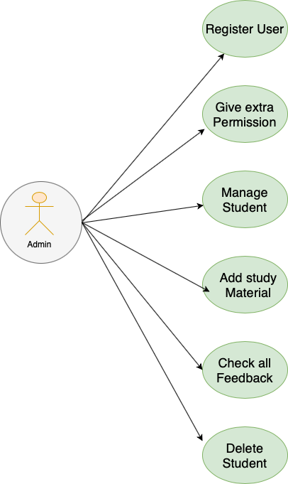
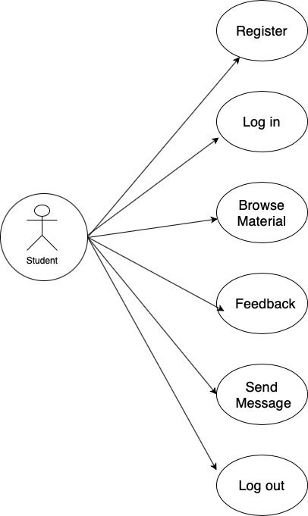
A use case diagram is a graphical depiction of a user's possible interactions with a system. A use case diagram shows various use cases and different types of users the system has and will often be accompanied by other types of diagrams as well
Use case Diagram

Slide 10
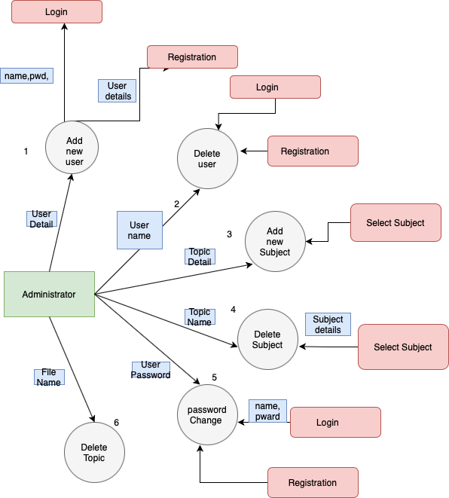
A Data Flow Diagram (DFD) is a traditional visual representation of the information flows within a system. A neat and clear DFD can depict the right amount of the system requirement graphically.
DFD Diagram

Slide 11
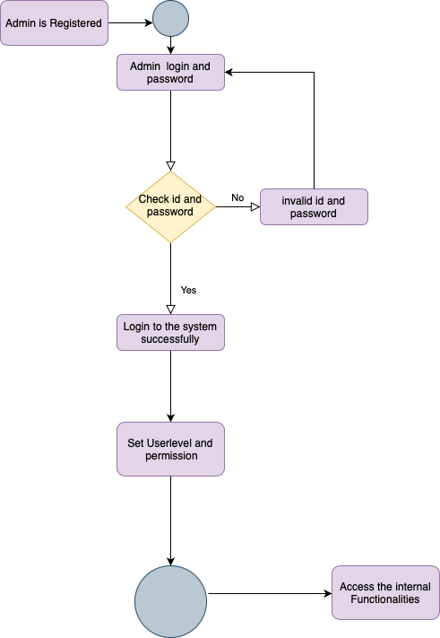
Activity Diagram
For Admin
An activity diagram portrays the control flow from a start point to a finish point showing the various decision paths that exist while the activity is being executed.

Slide 12
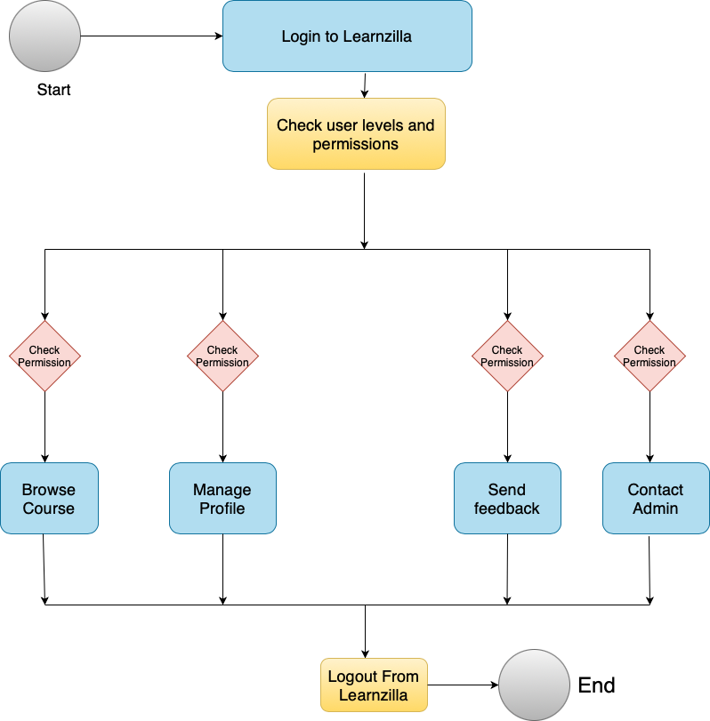
Student

Slide 13
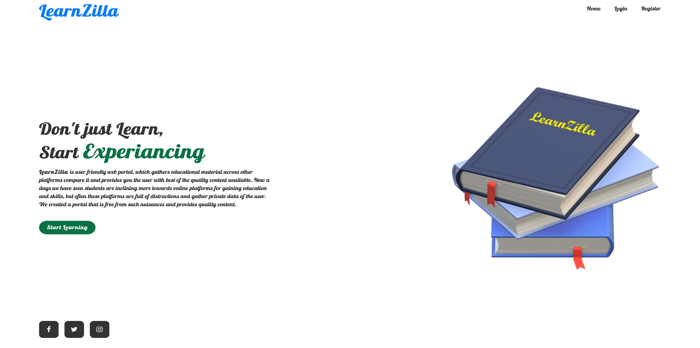
Snapshots of Major Projects:

Slide 14
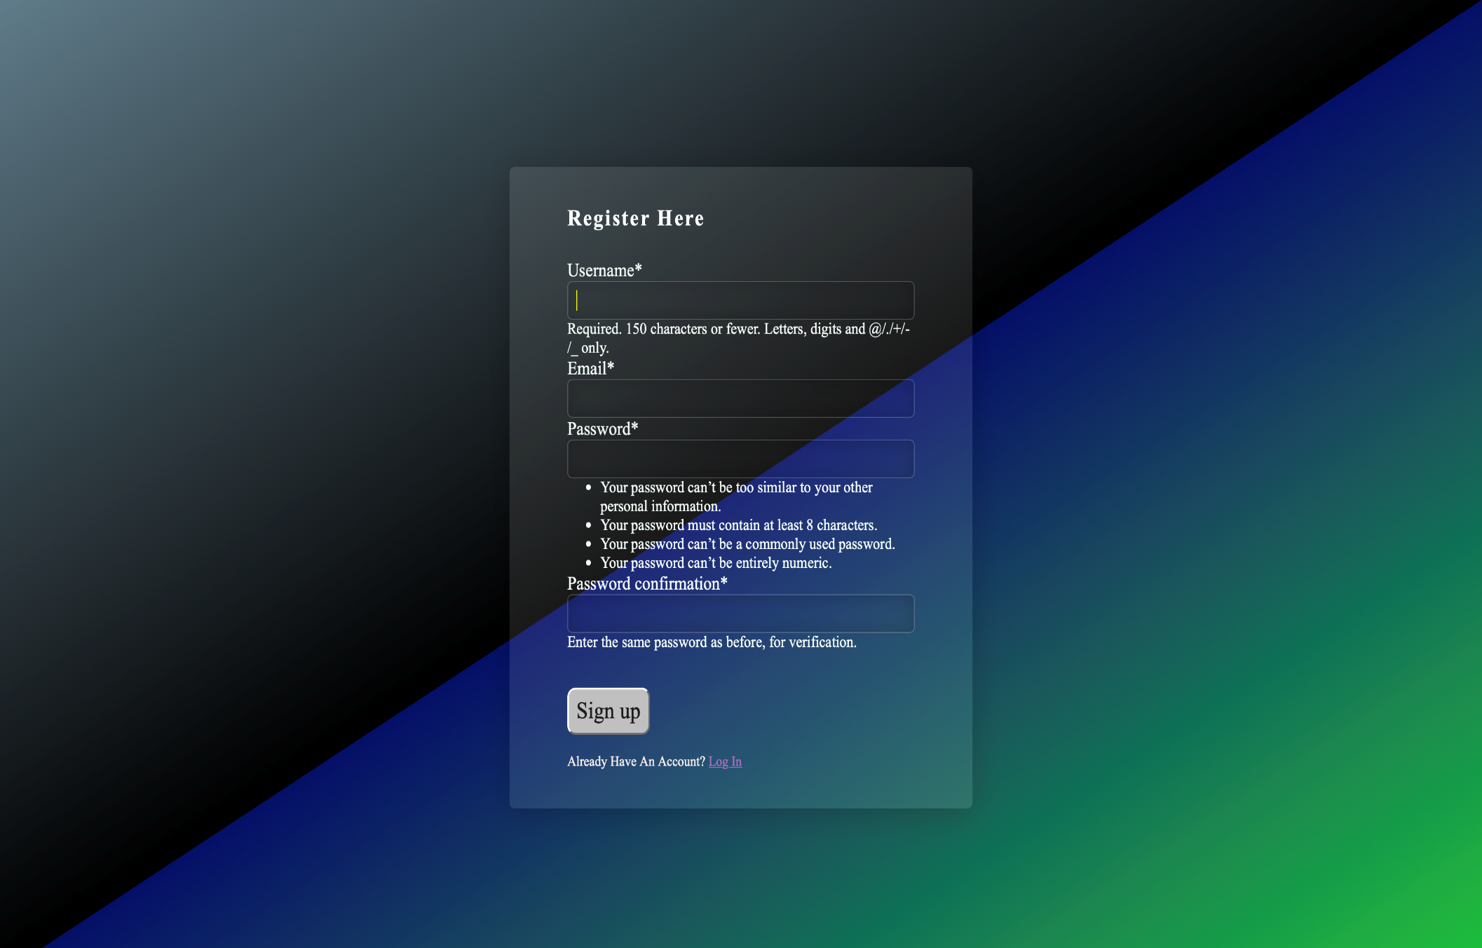
Registration page

Slide 15
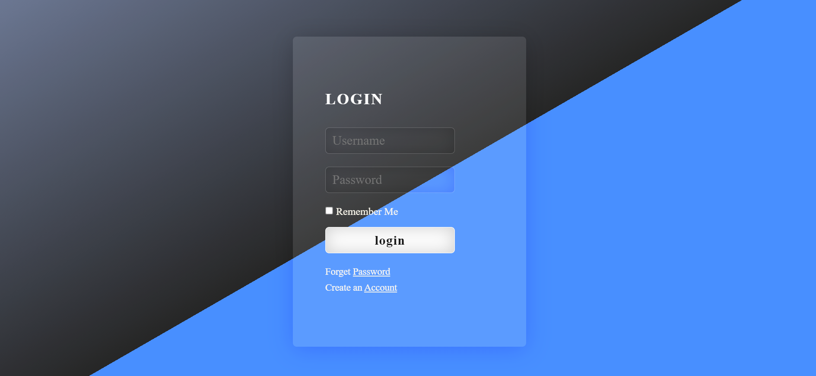
Login Page

Slide 16
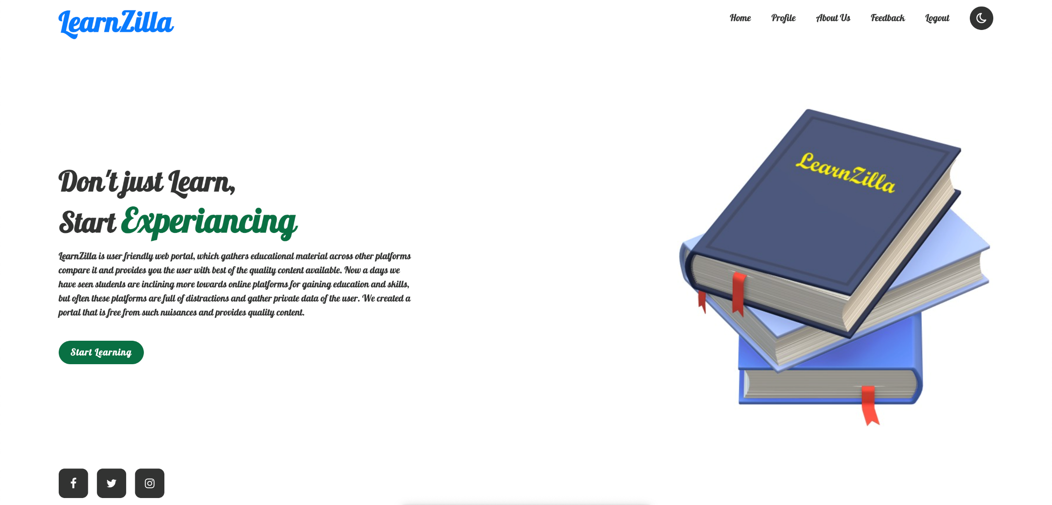
Home Page after login

Slide 17
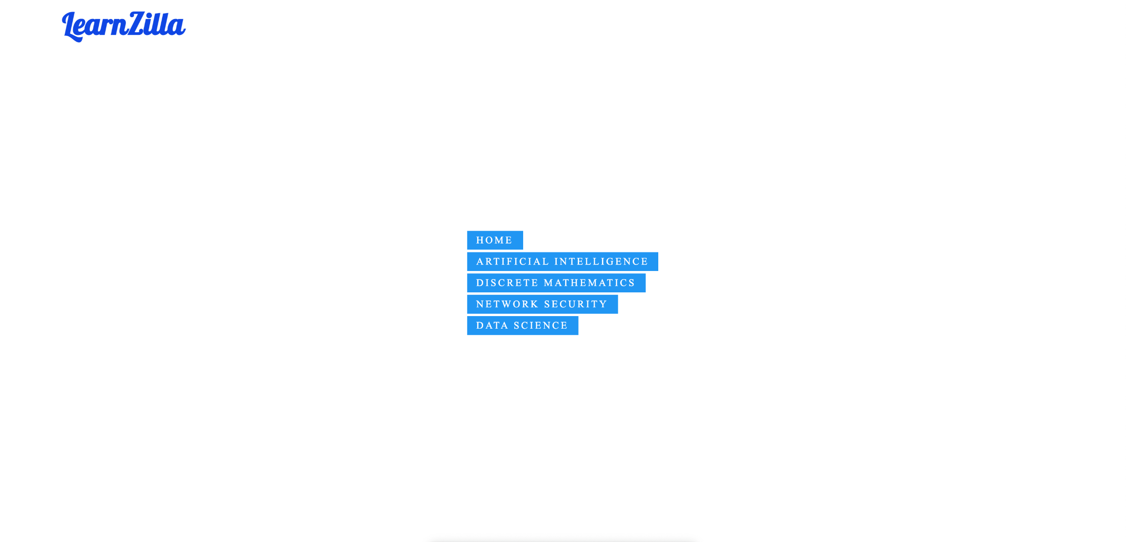
Subjects page

Slide 18
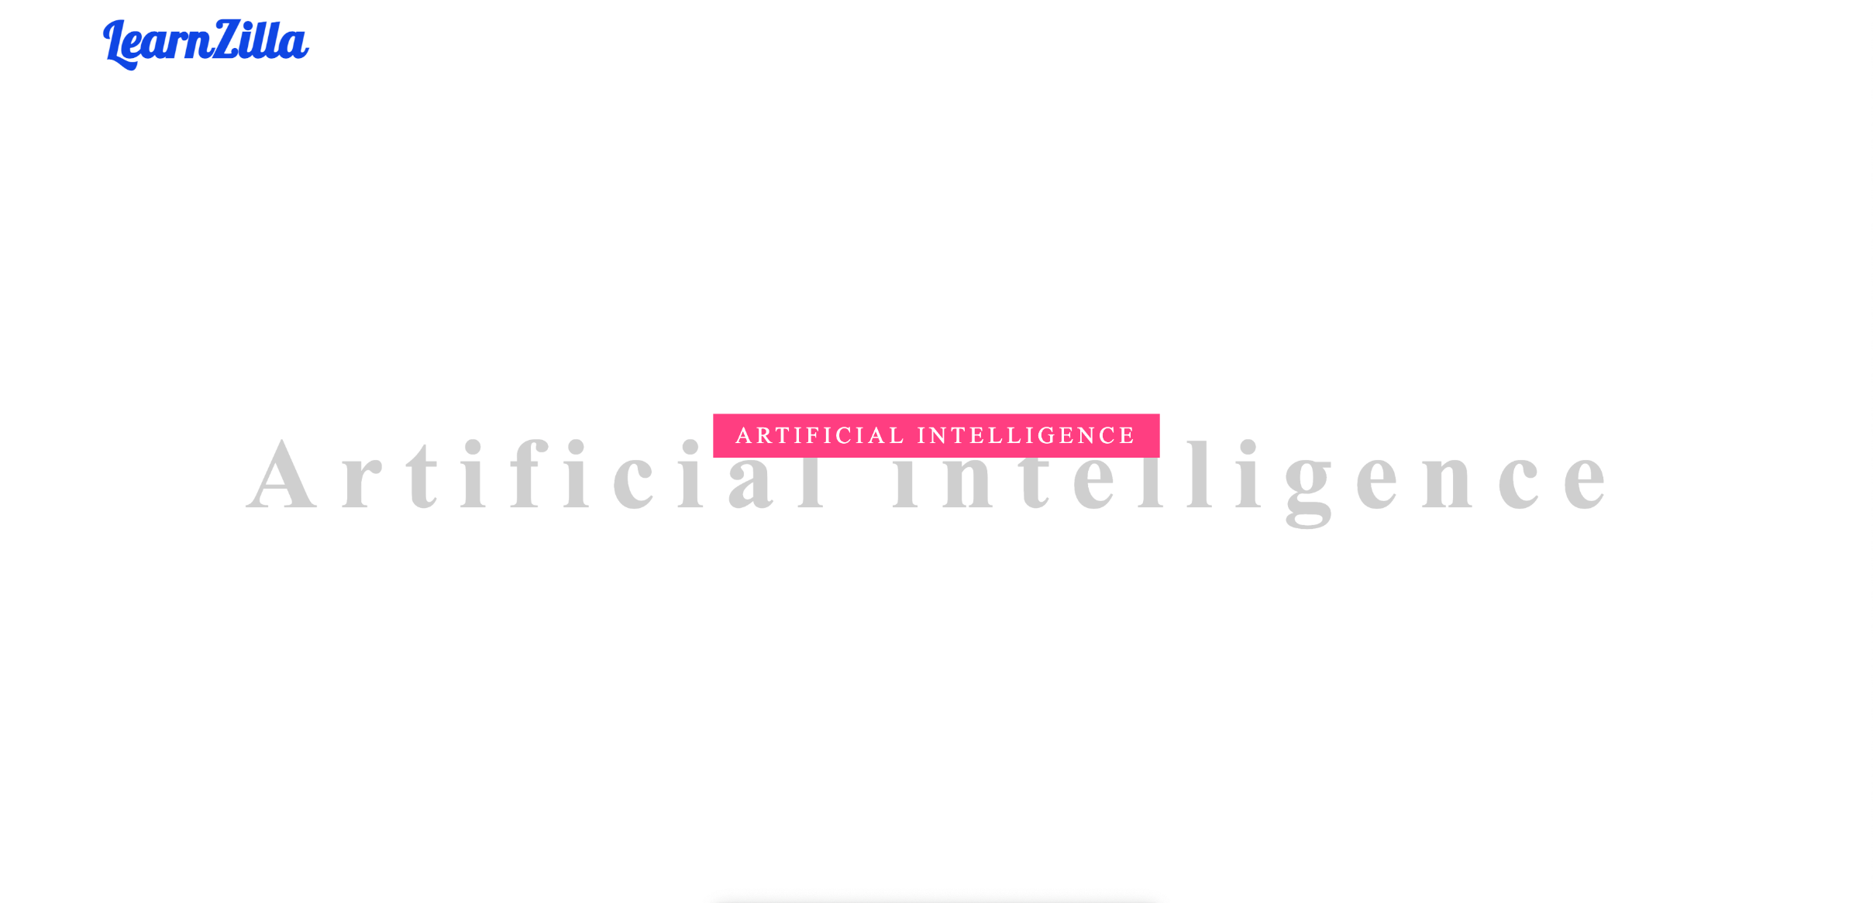
Selecting a specific subject

Slide 19
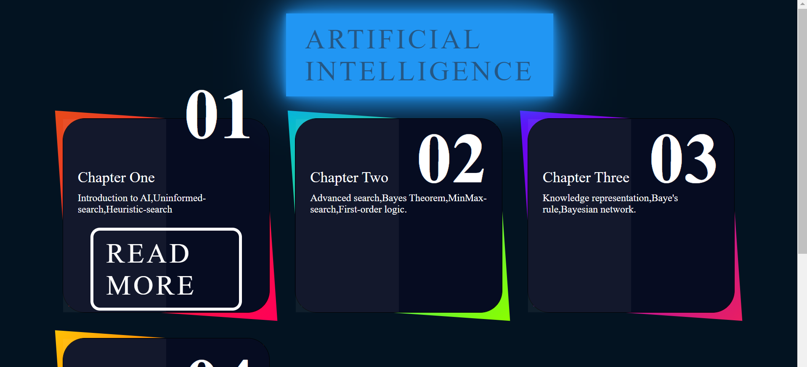

Slide 20
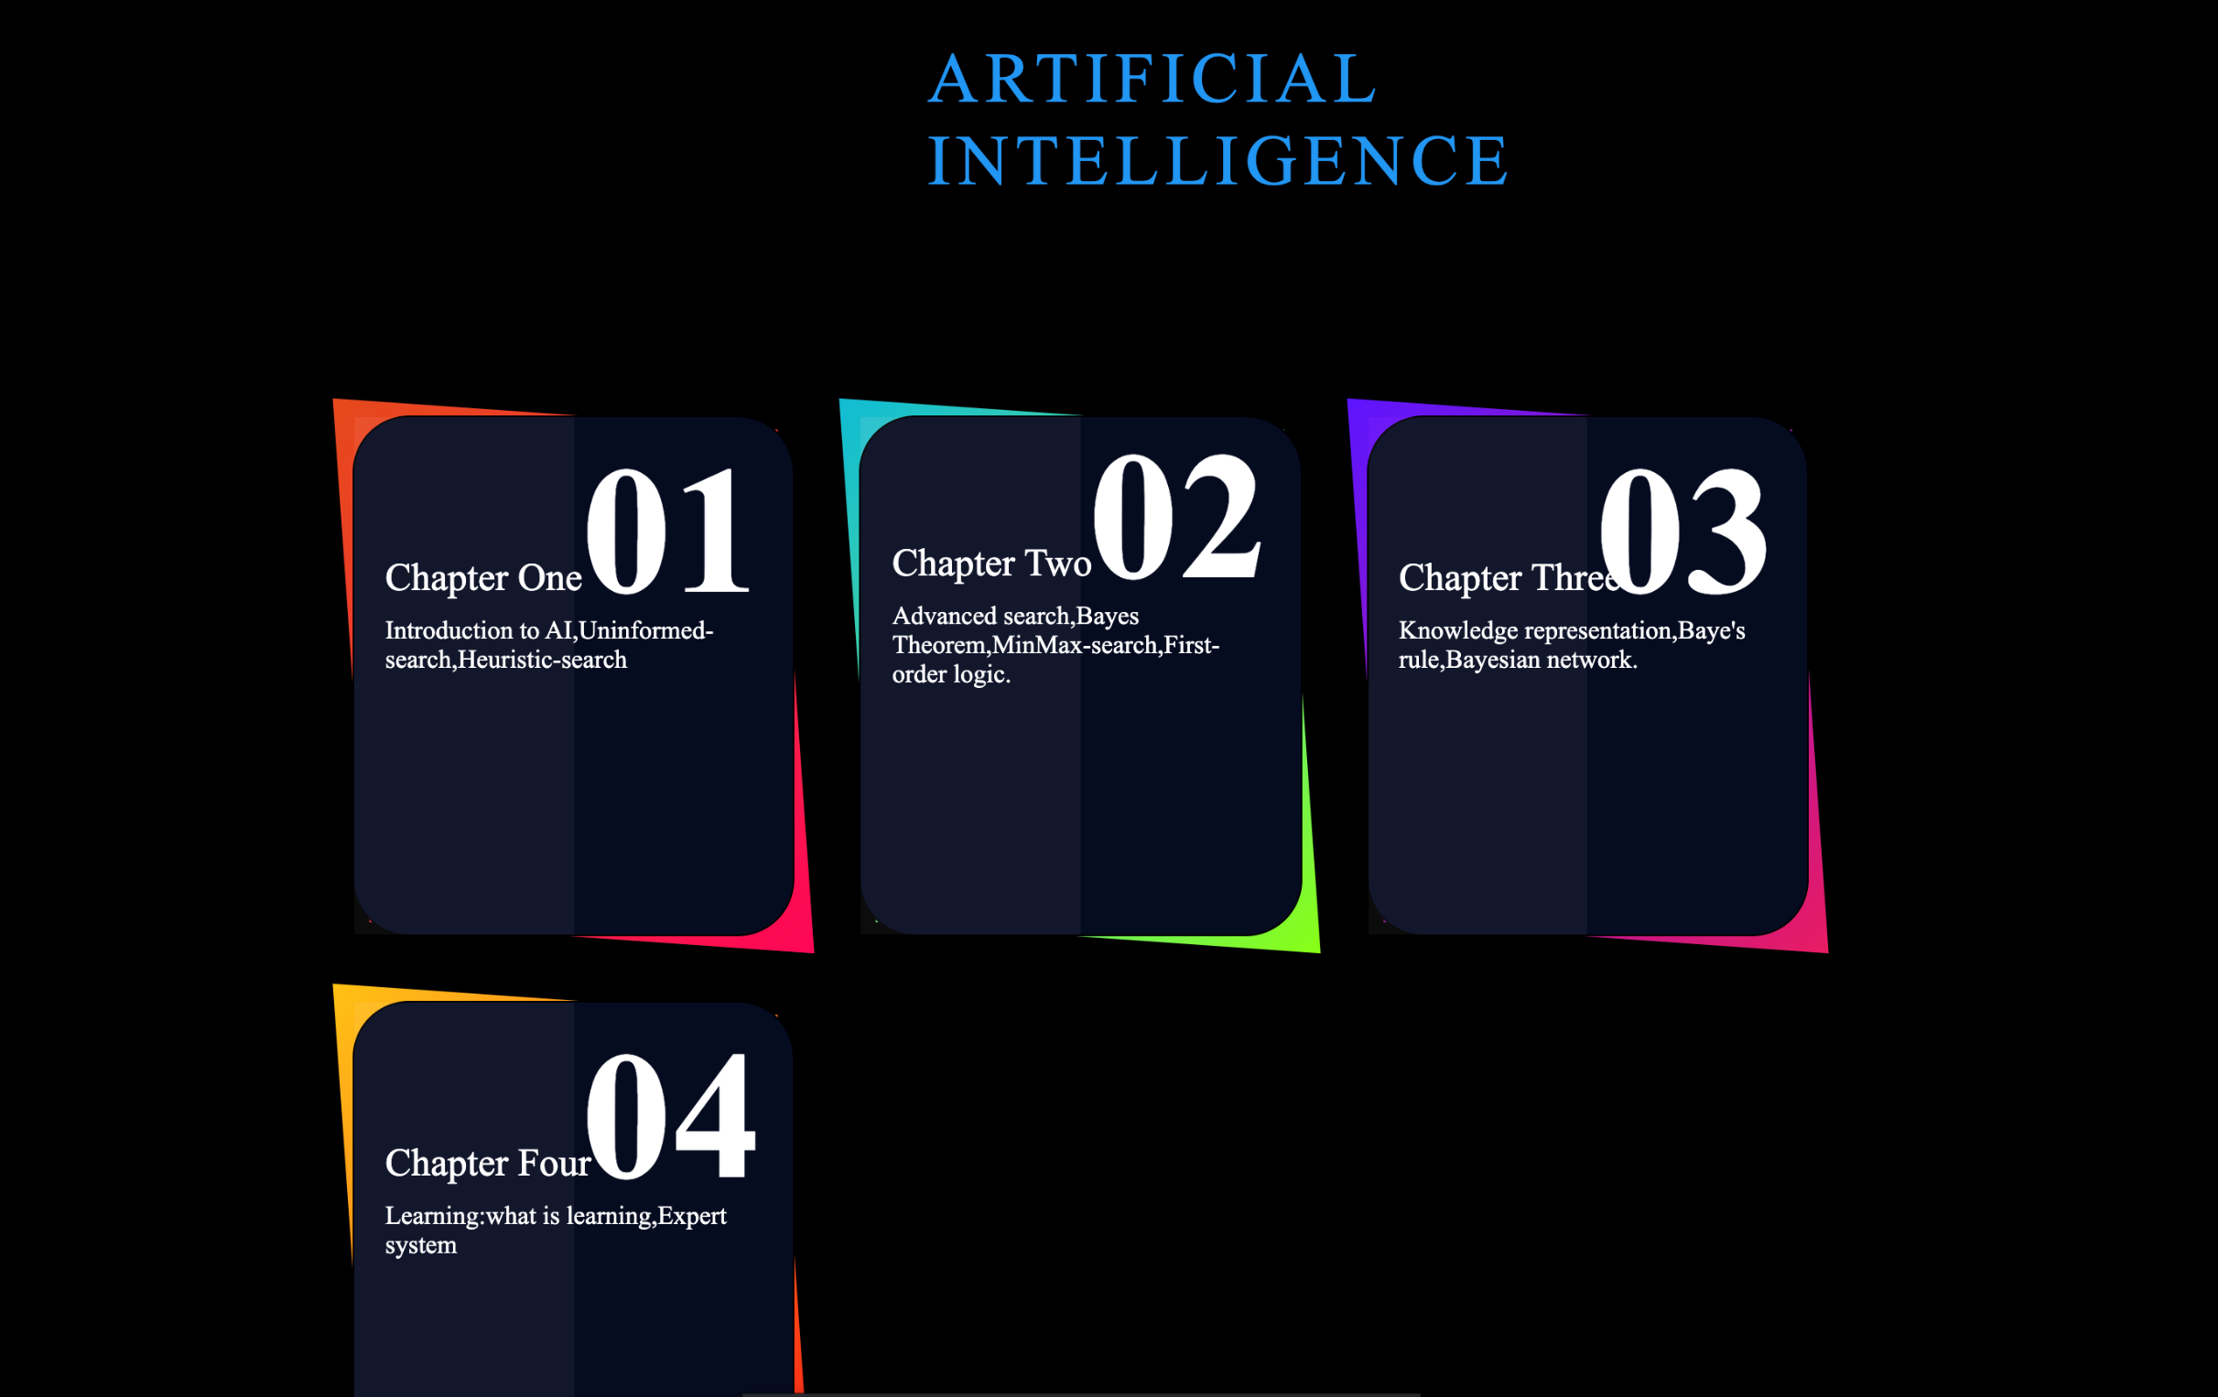

Slide 21
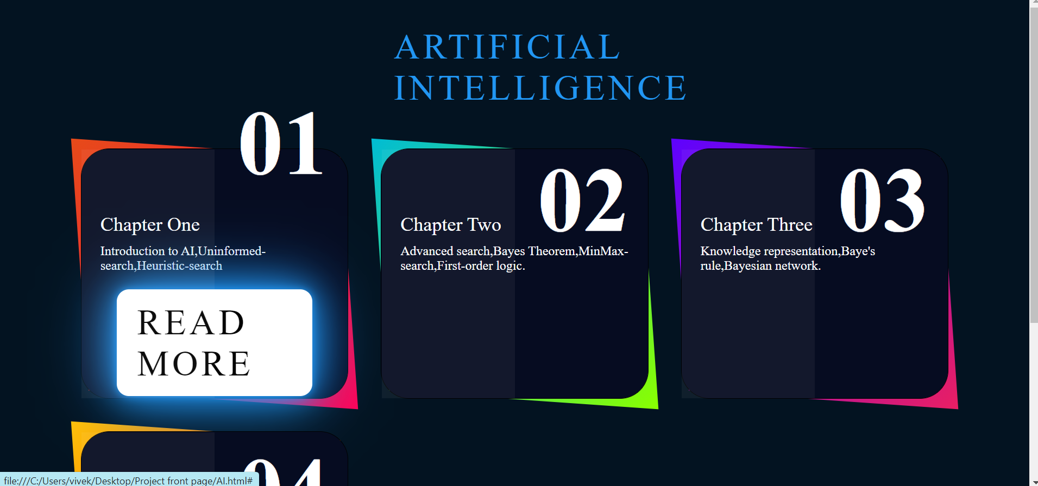
Hover effects on Subject page

Slide 22
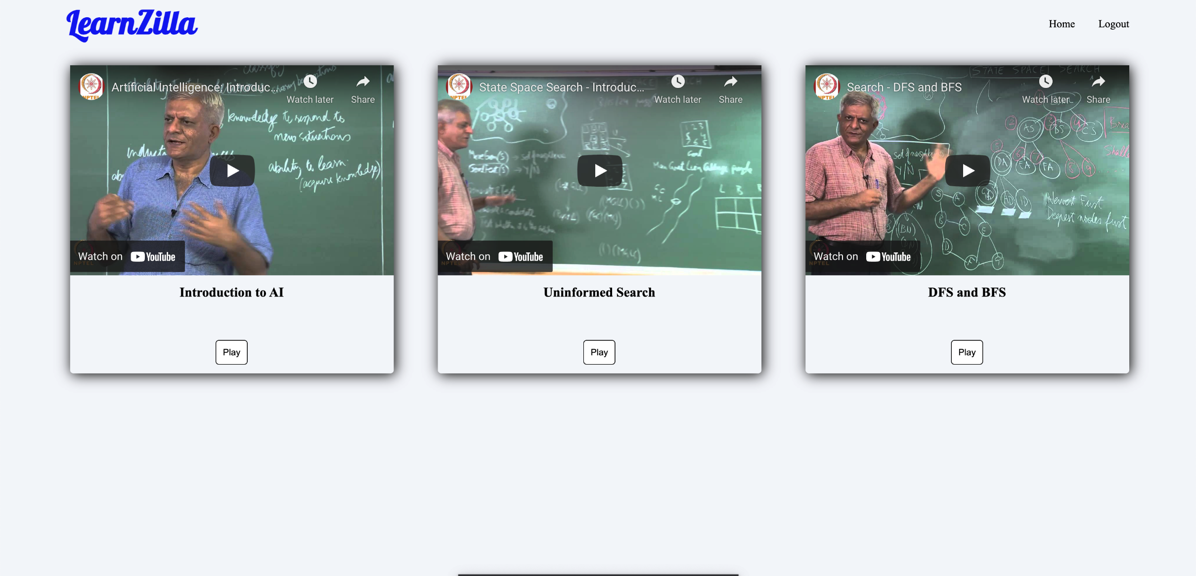
Content provided in one of the pages

Slide 23
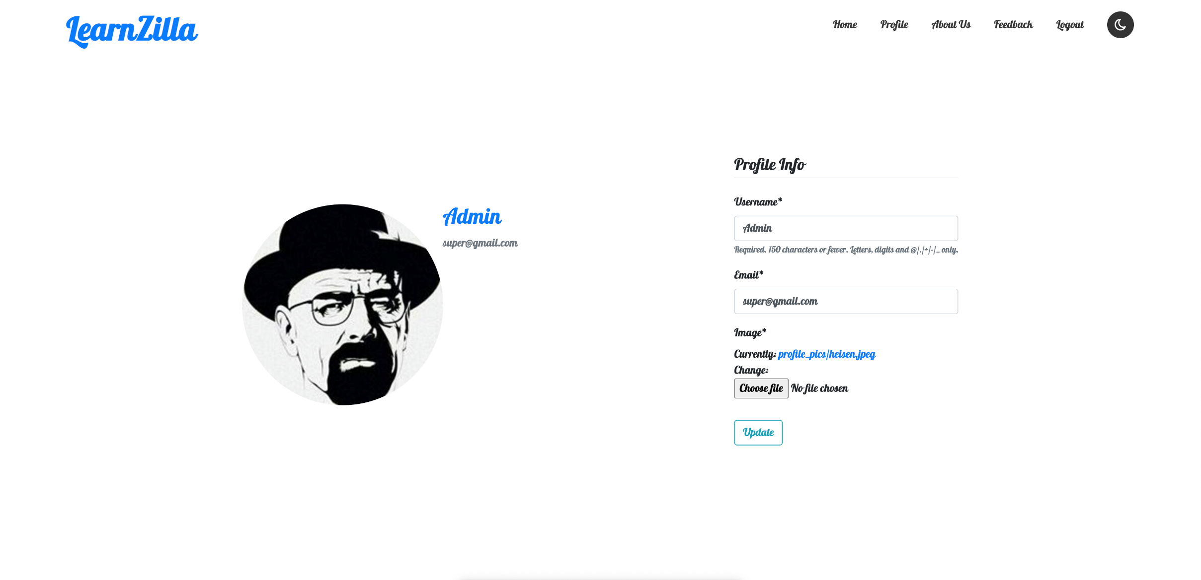
Profile page

Slide 24
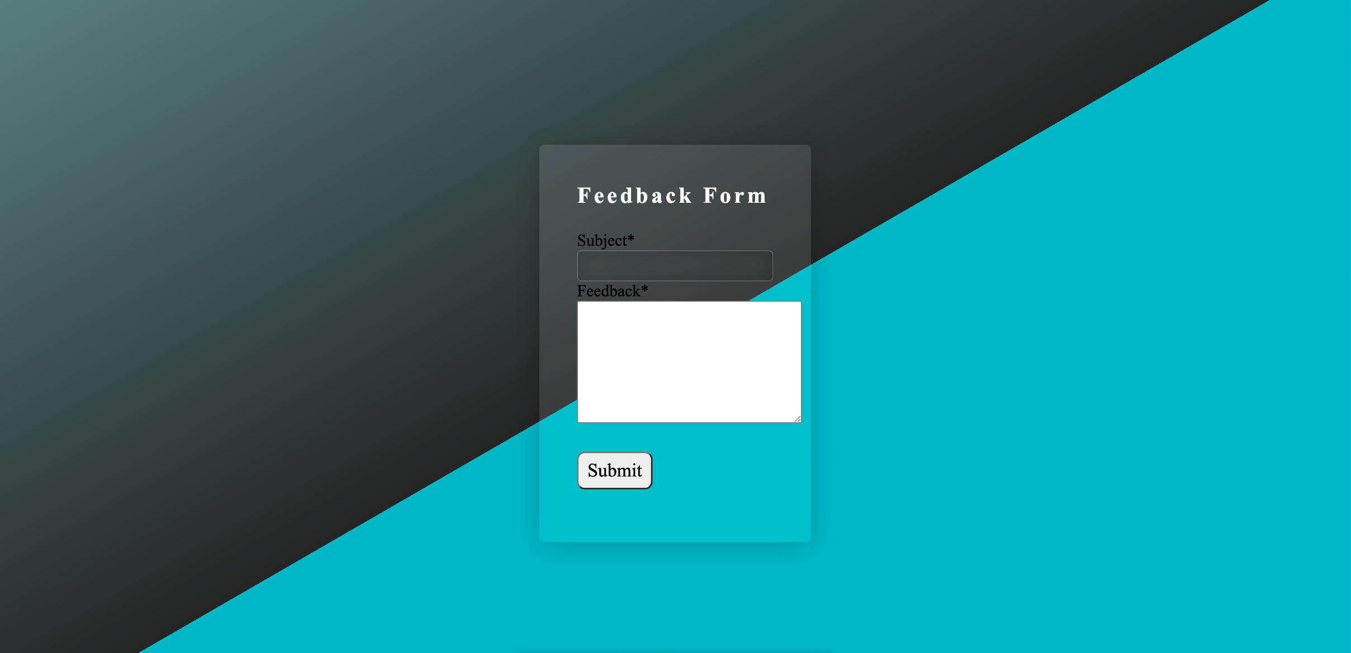
Feedback form

Slide 25
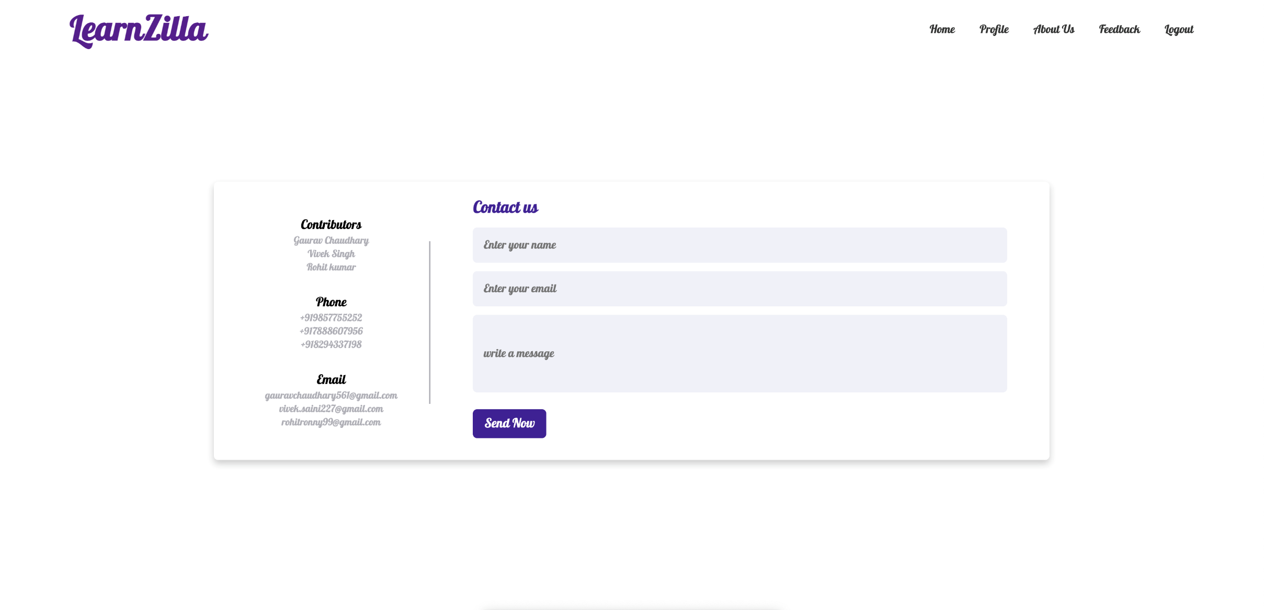
Contact us page

Slide 26
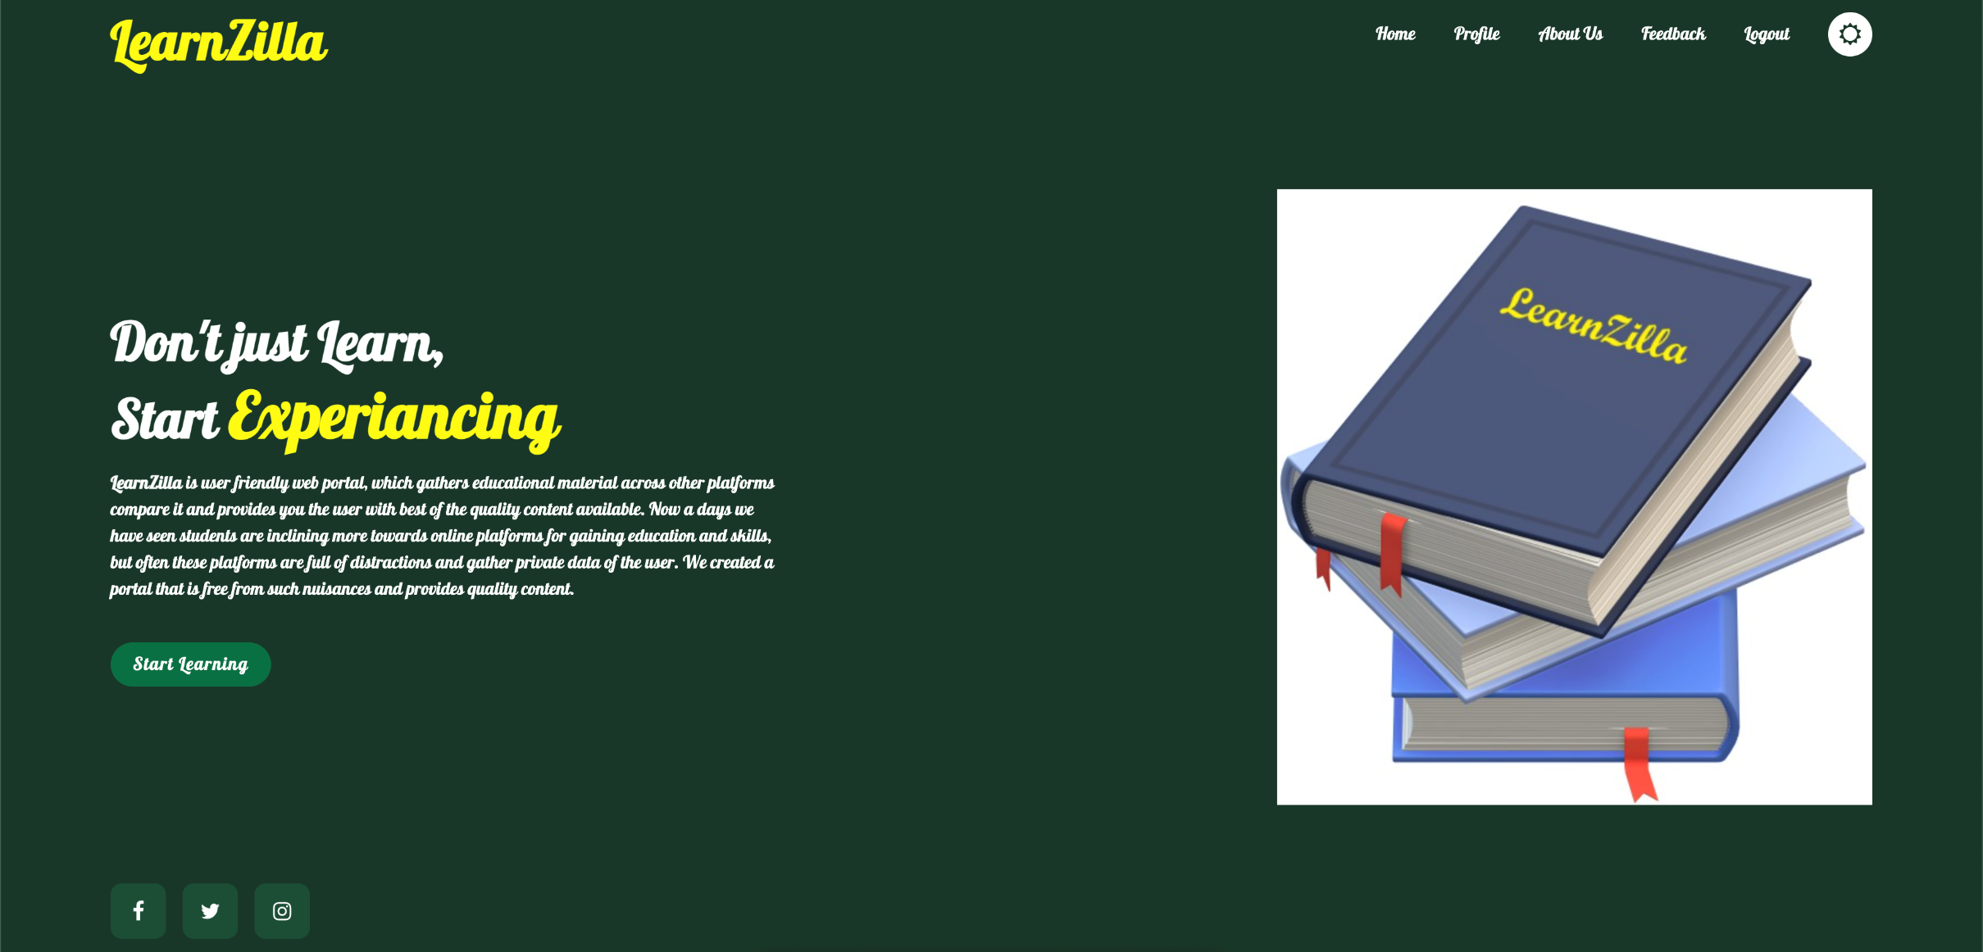
Dark mode switched on

Slide 27
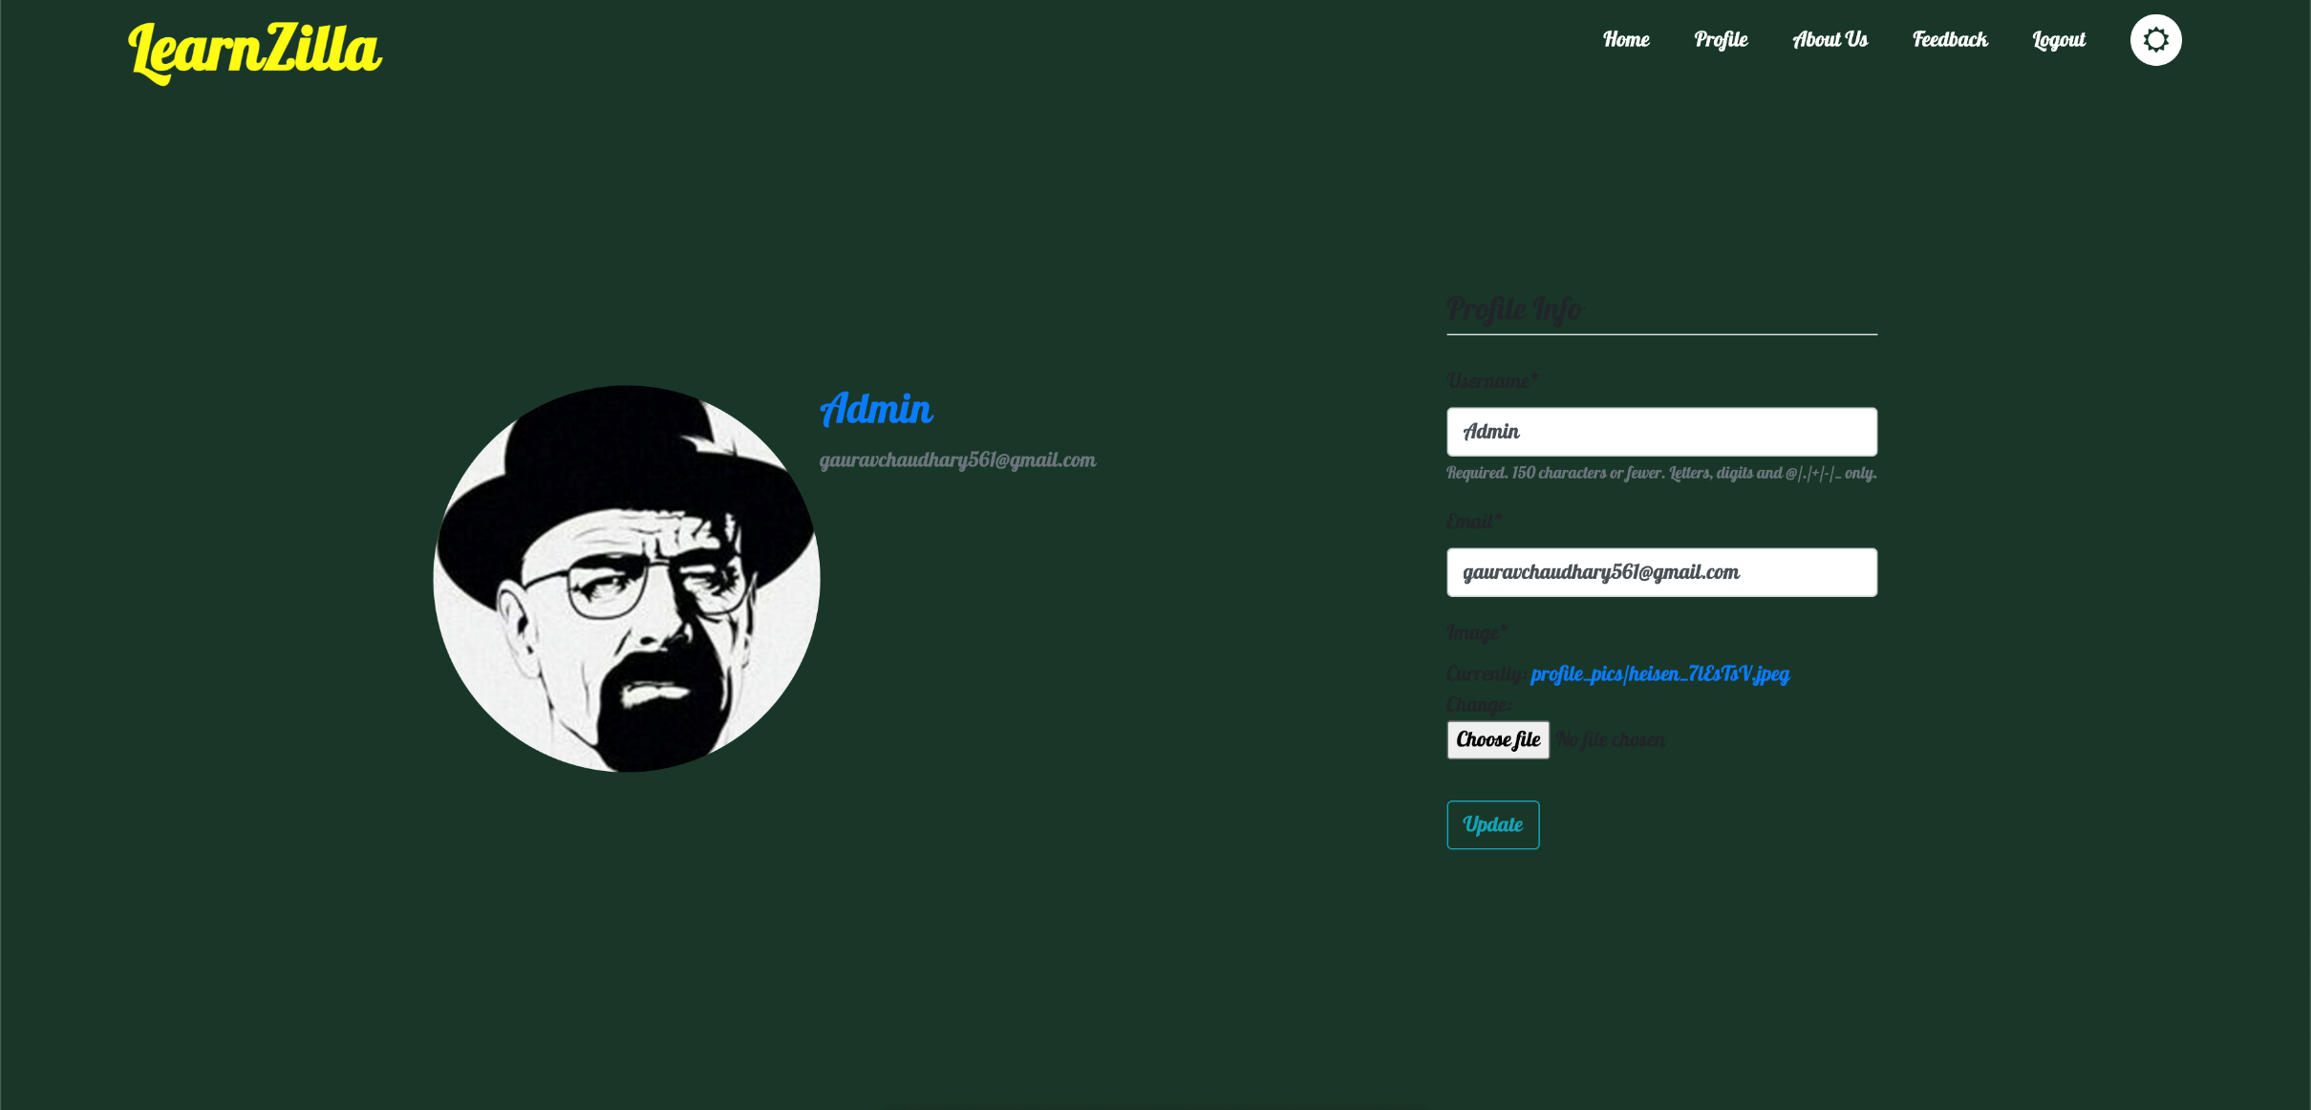
Dark mode on profile page

Slide 28
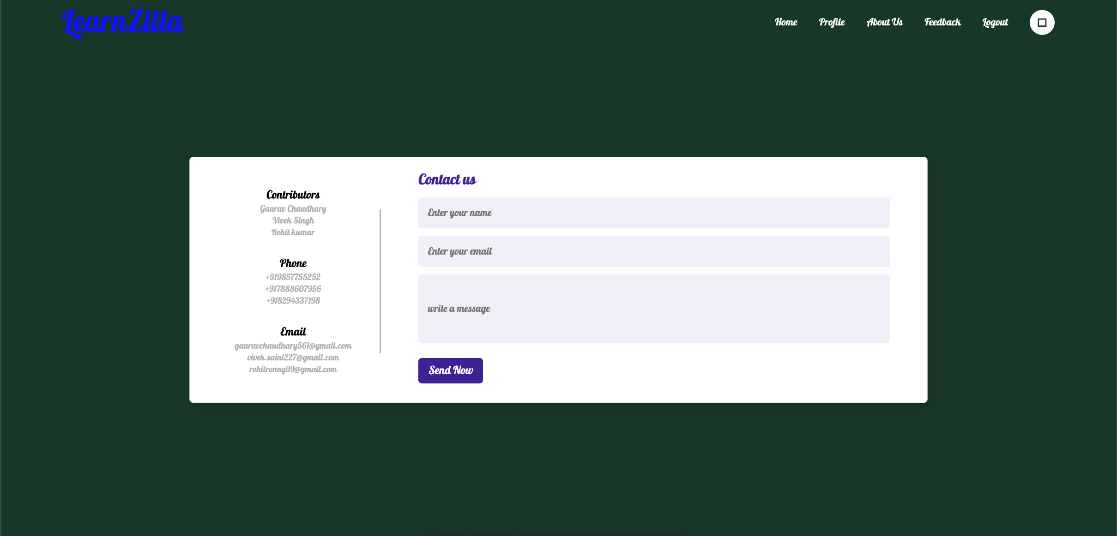
Dark mode on contact us page

Slide 29
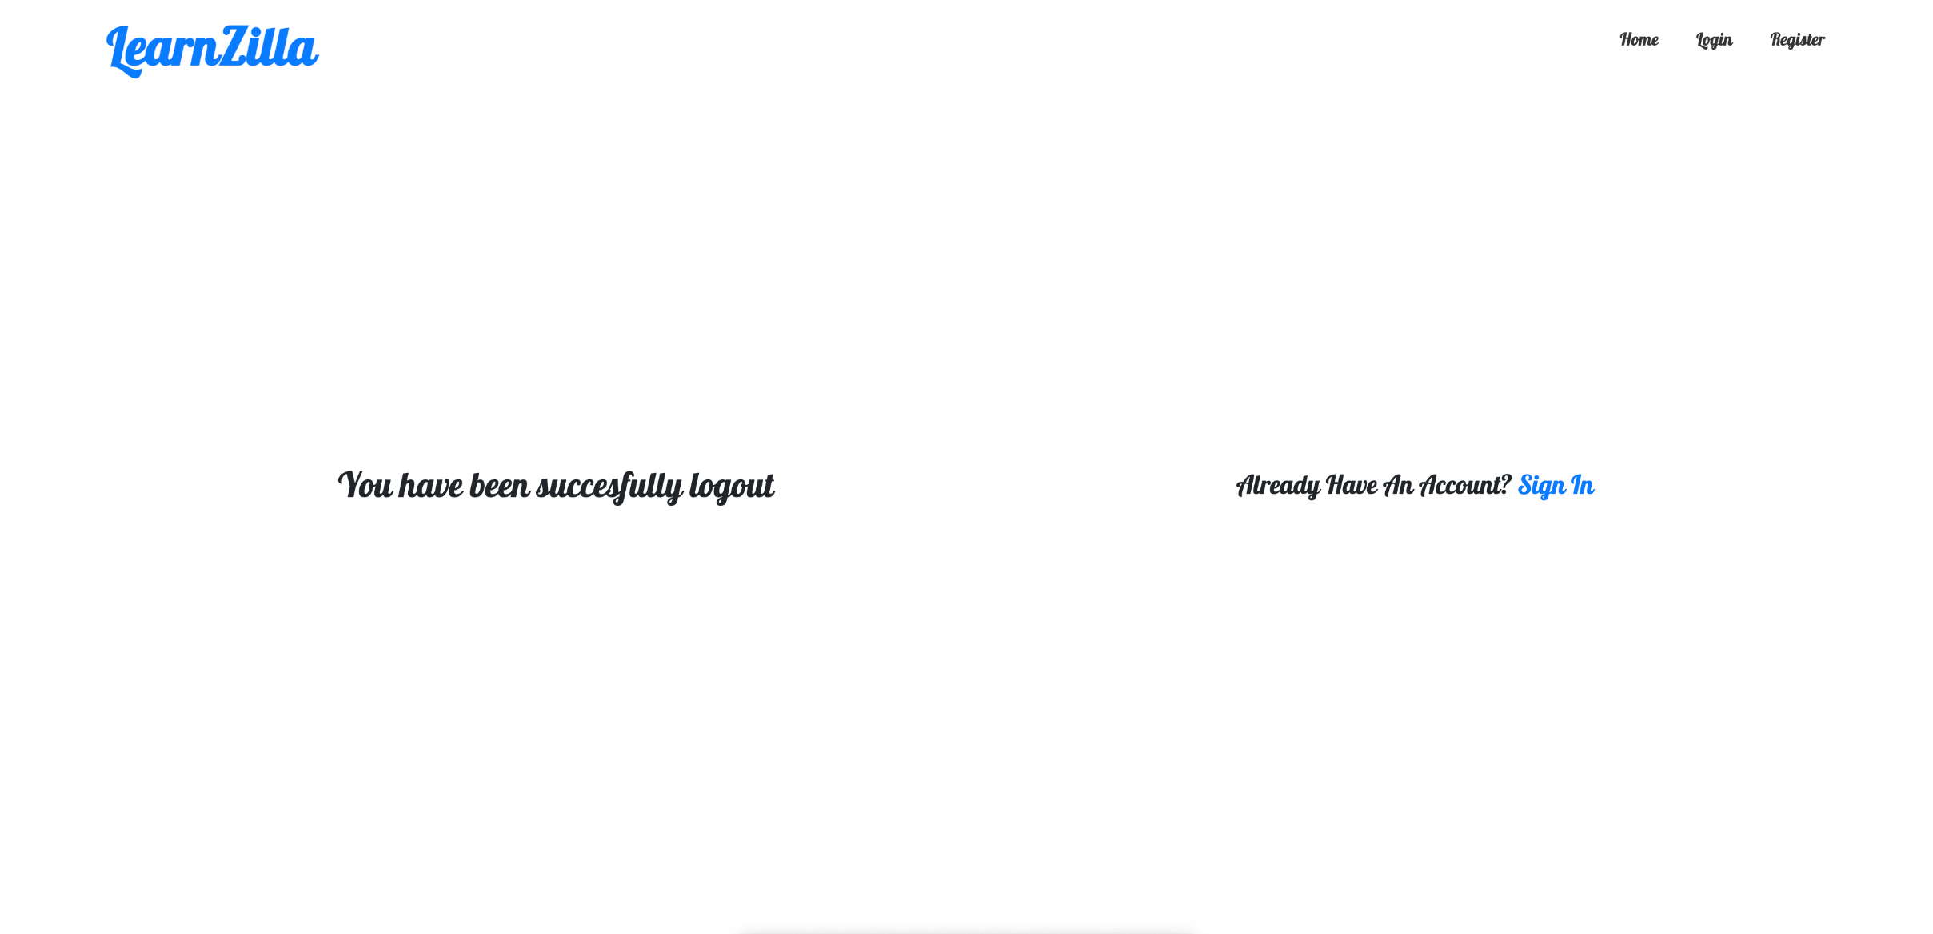
Log-Out page

Slide 30
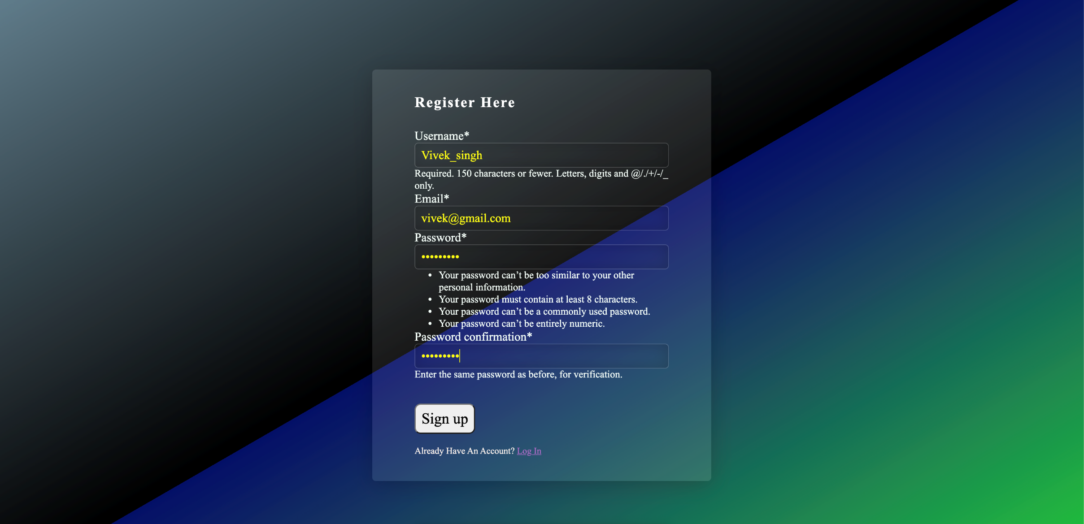
Registration with a Test User

Slide 31
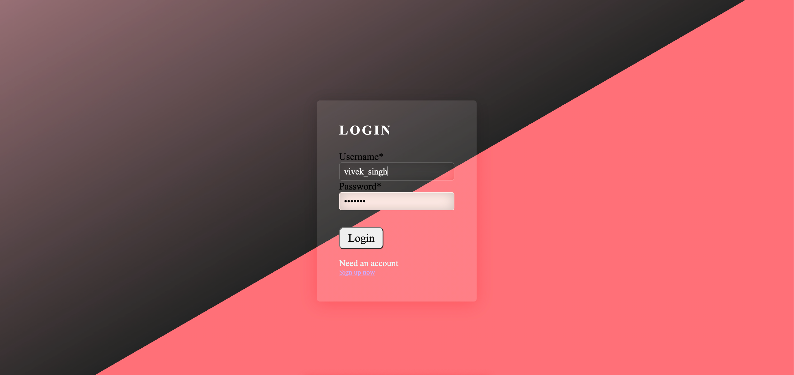
Login with a Test user

Slide 32
Home page after login through vivek’ account

Slide 33
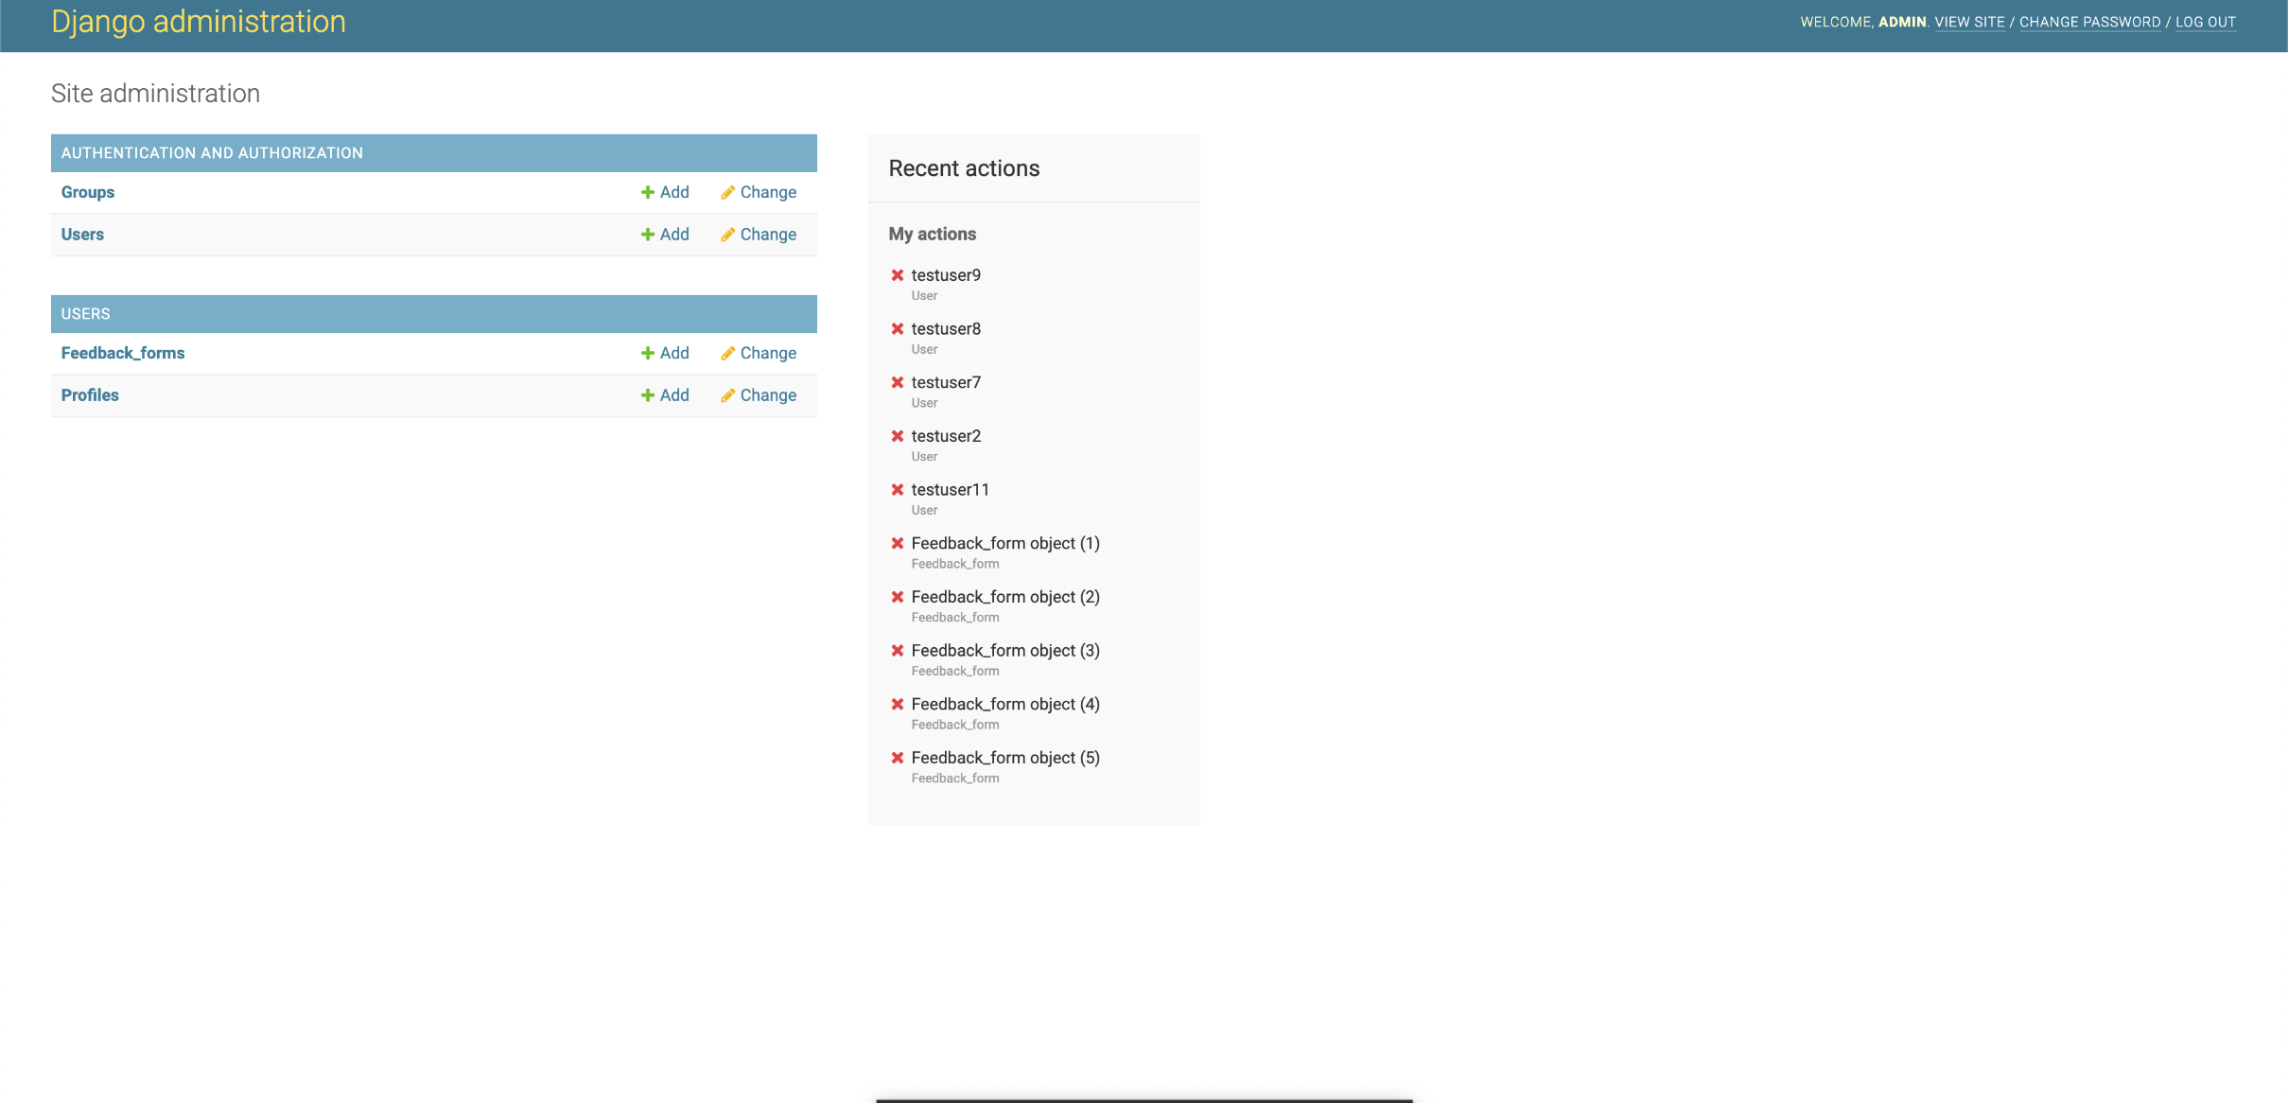
Django admin

Slide 34
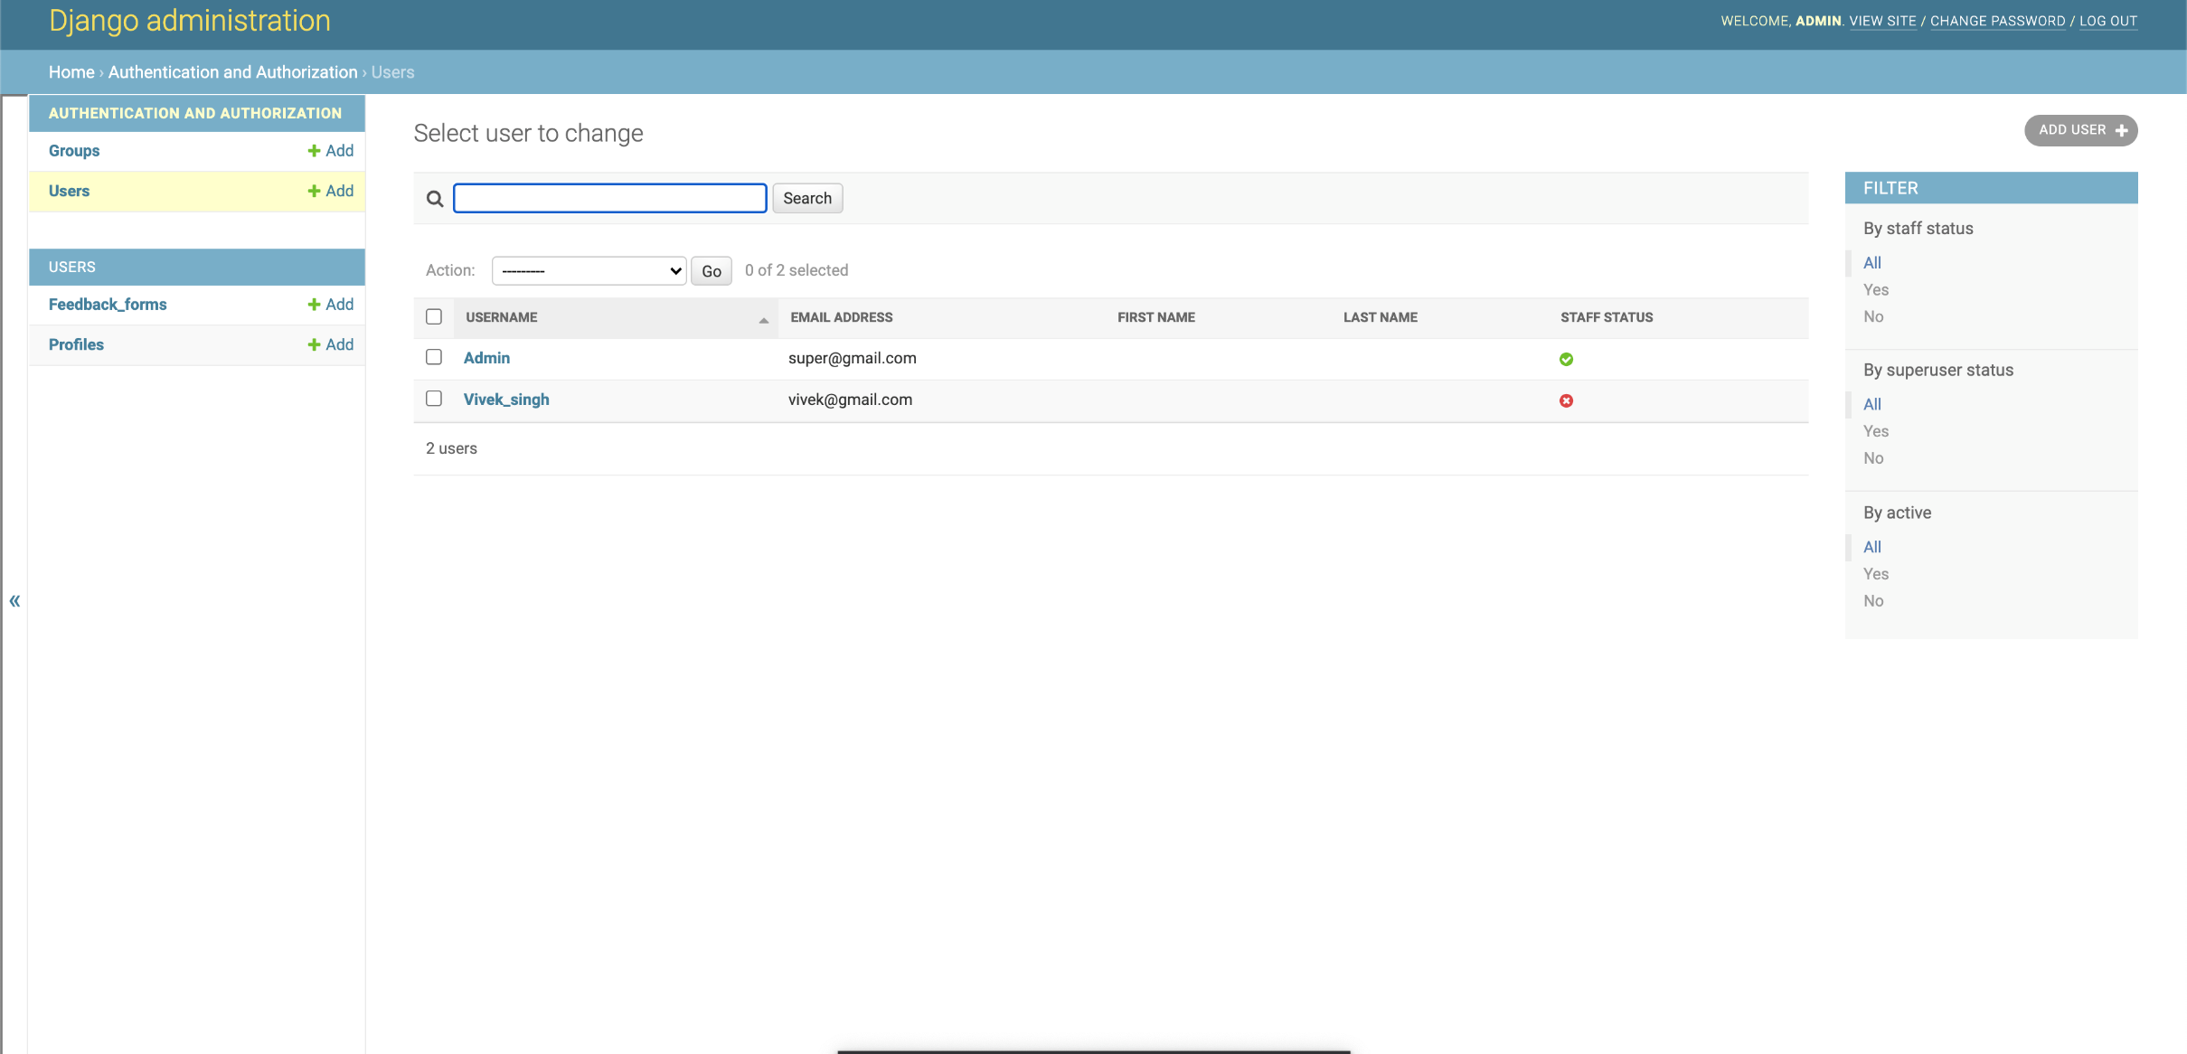
Available users in our website

Slide 35
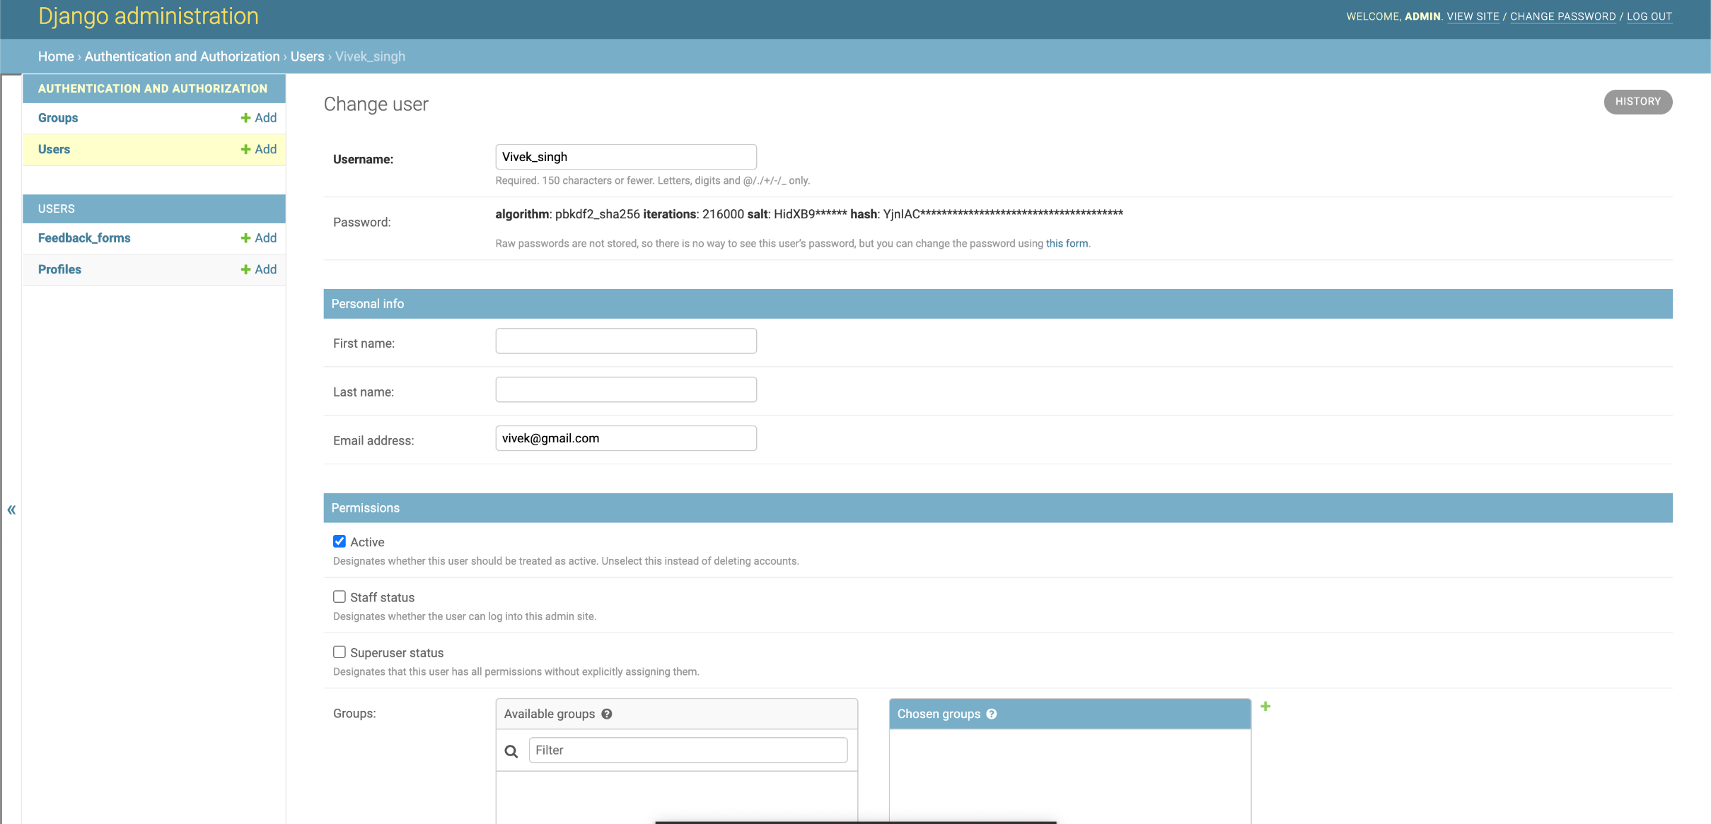
Specific Profile our created user Vivek_singh

Slide 36
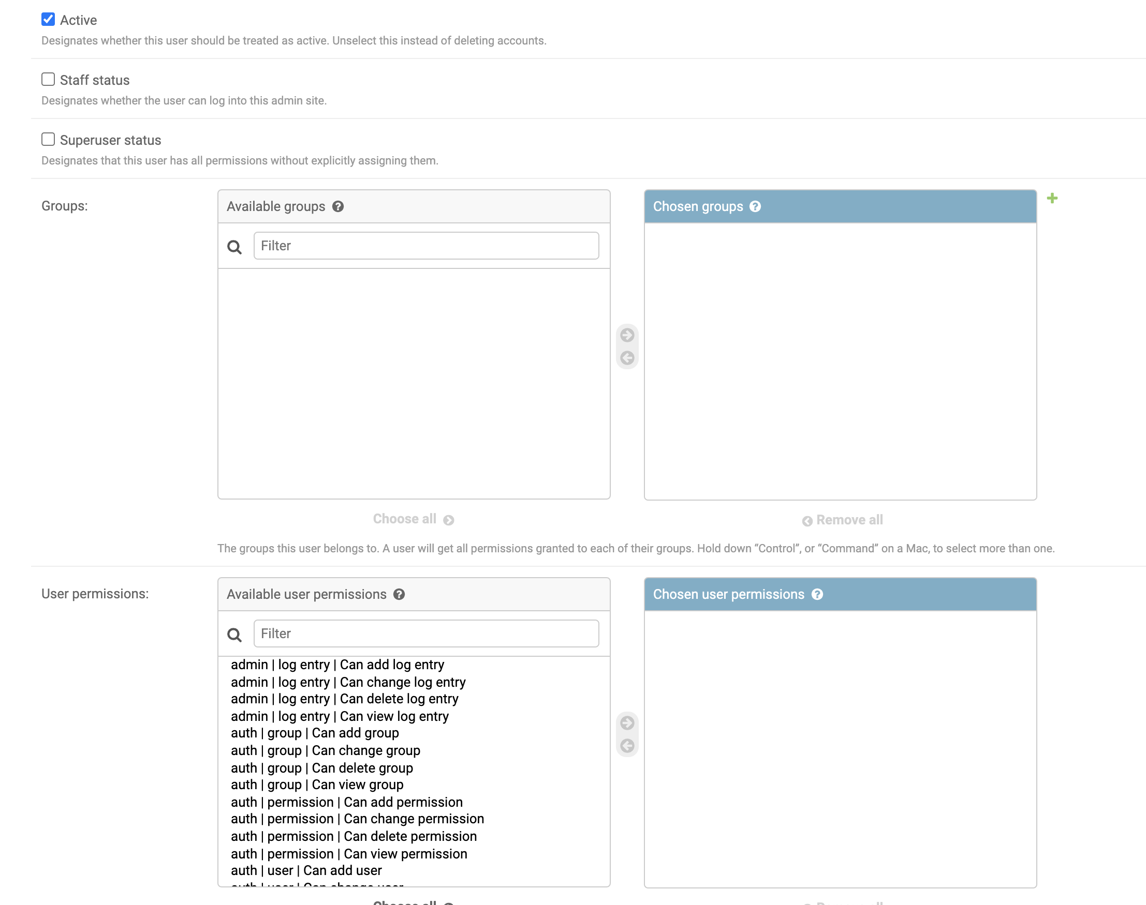
Further details

Slide 37
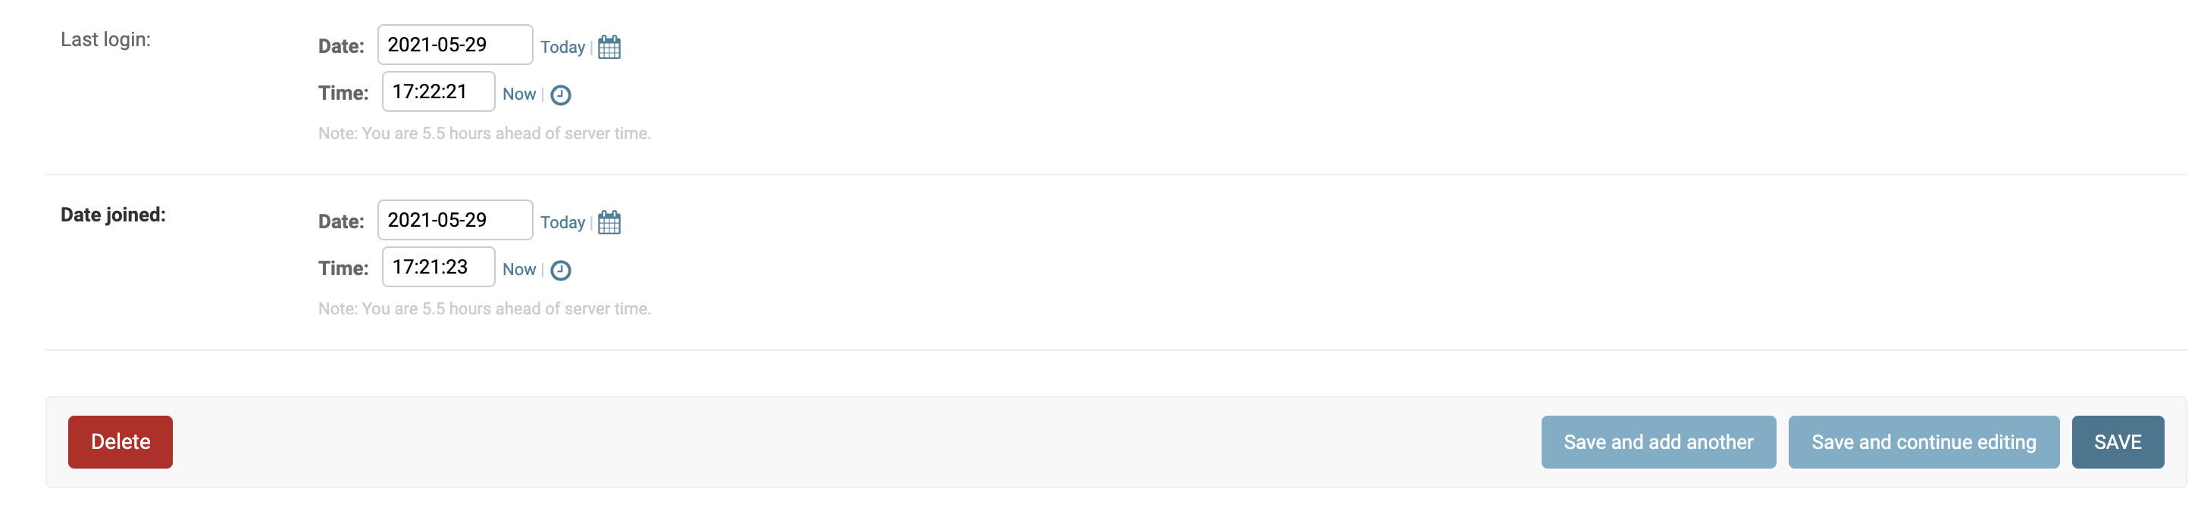
Deleting, Updating profile in admin page

Slide 38
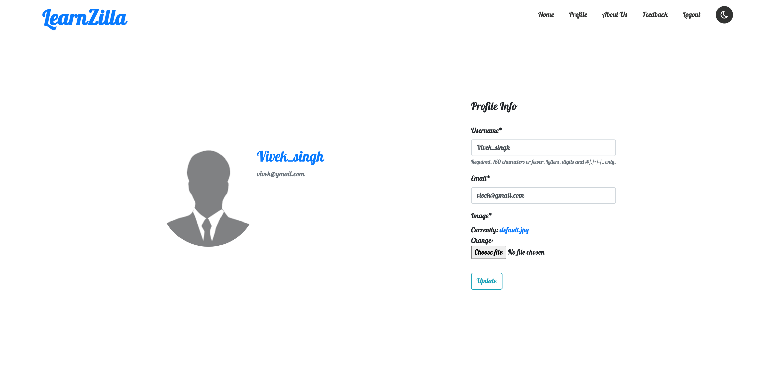
Profile page

Slide 39
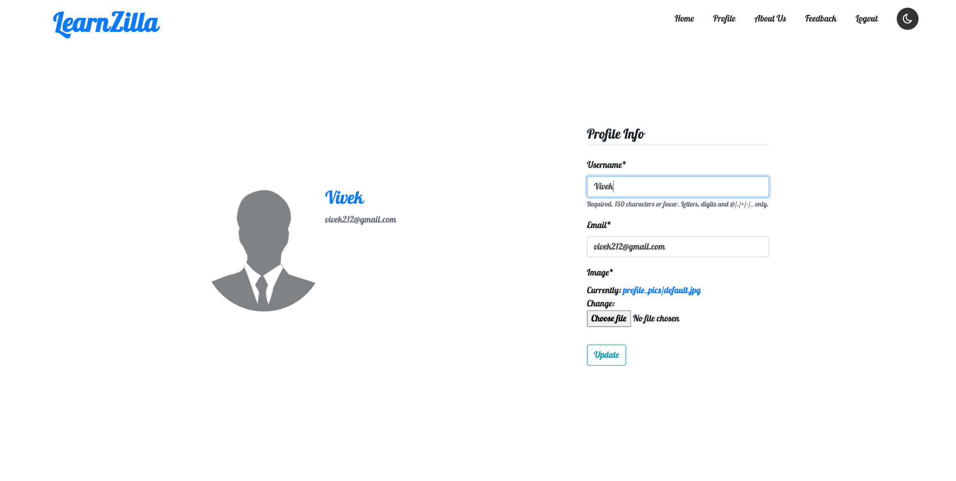
Updating profile under admin page

Slide 40
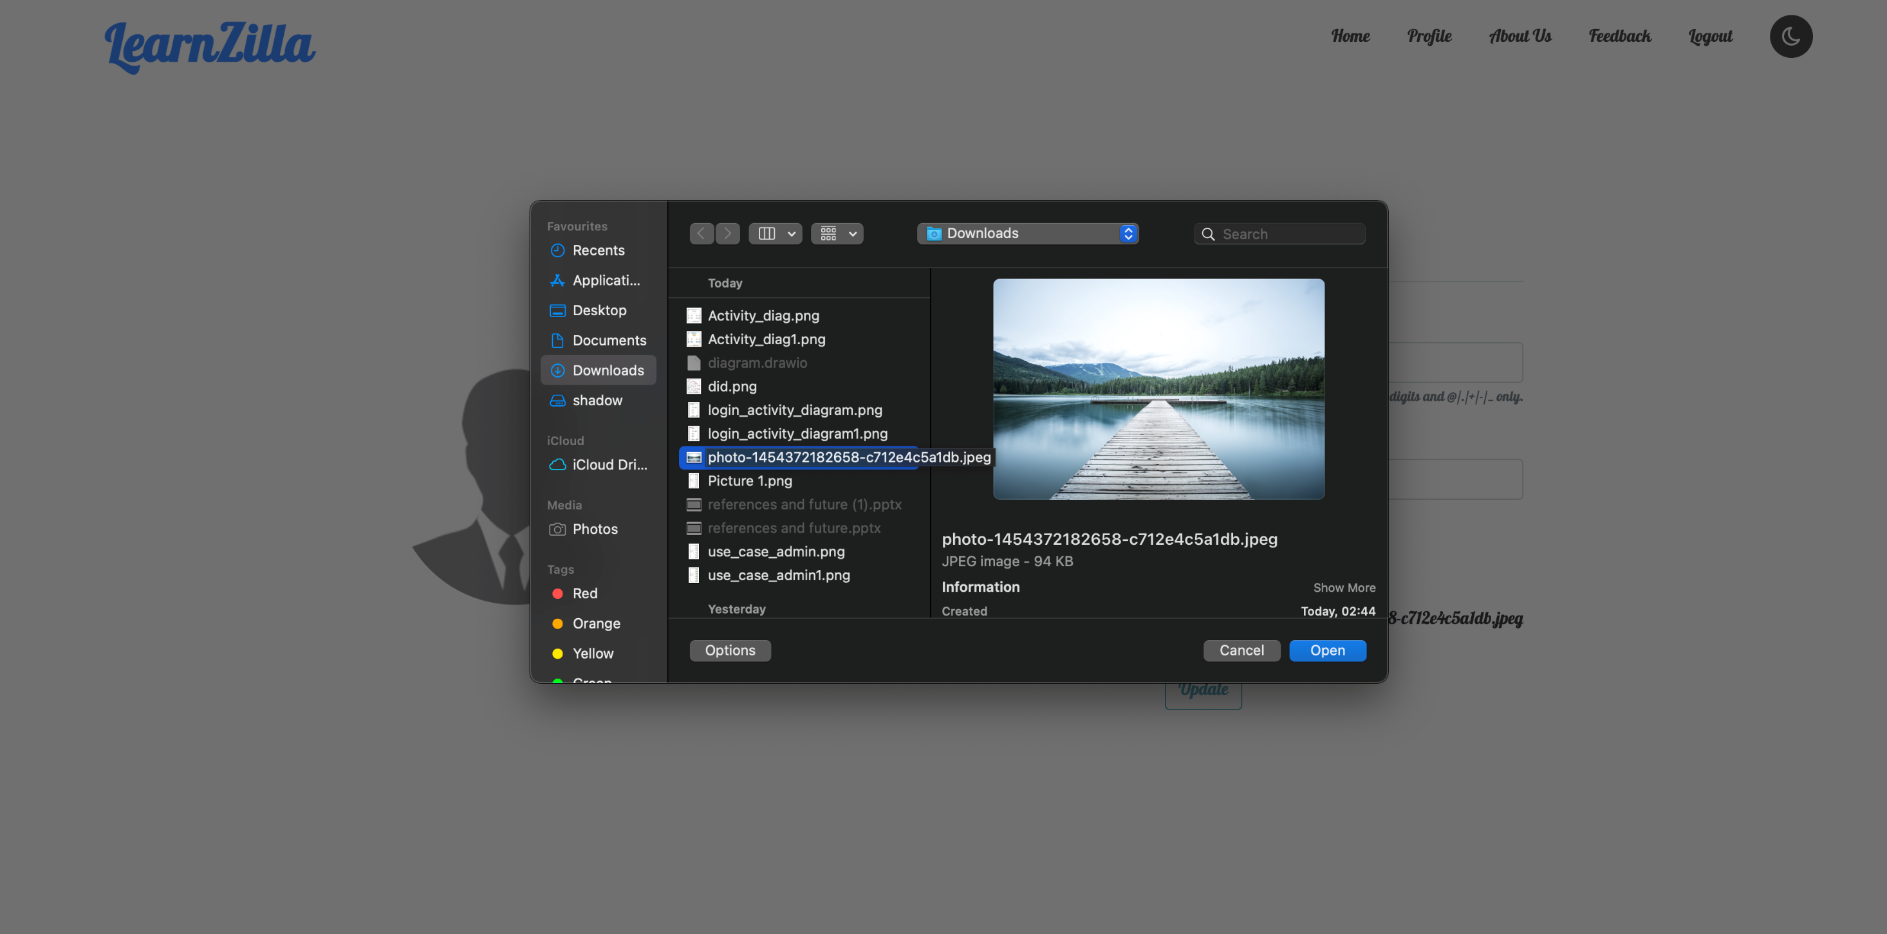

Slide 41
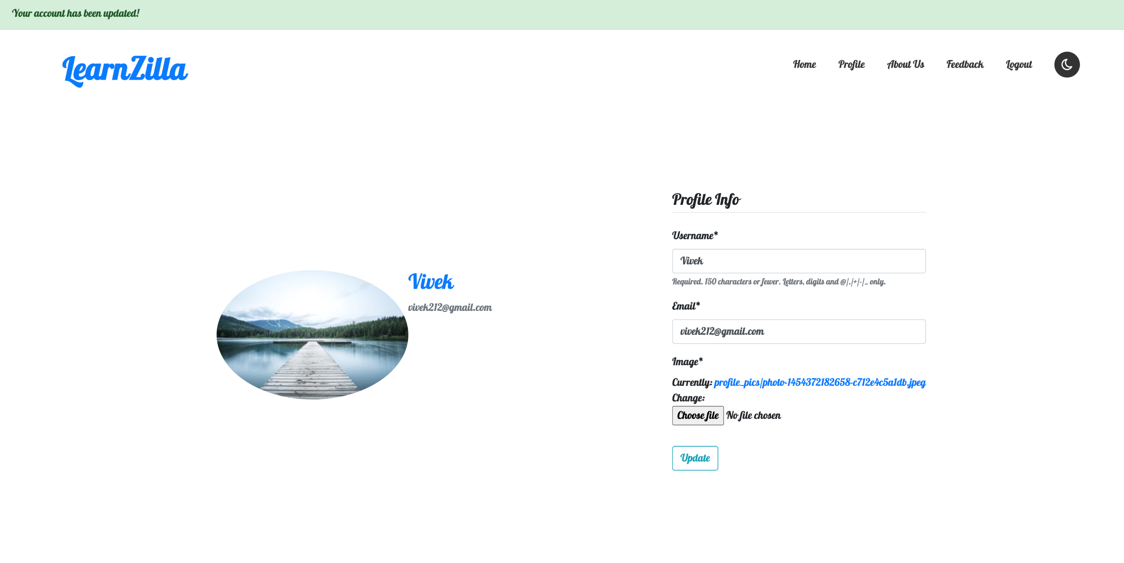

Slide 42
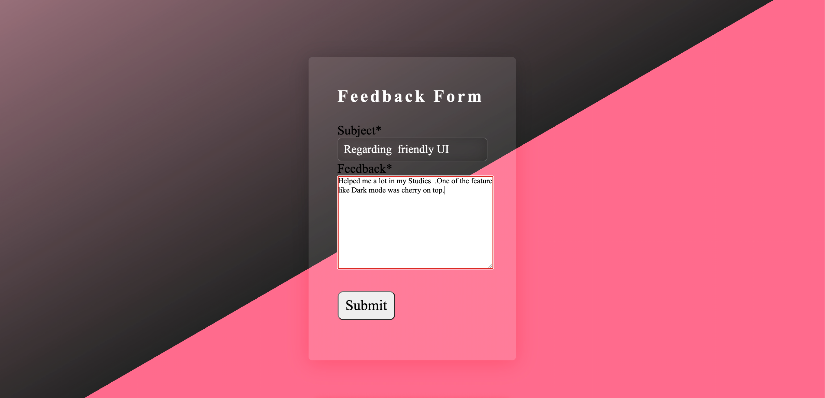
Giving Feedback with a test user

Slide 43
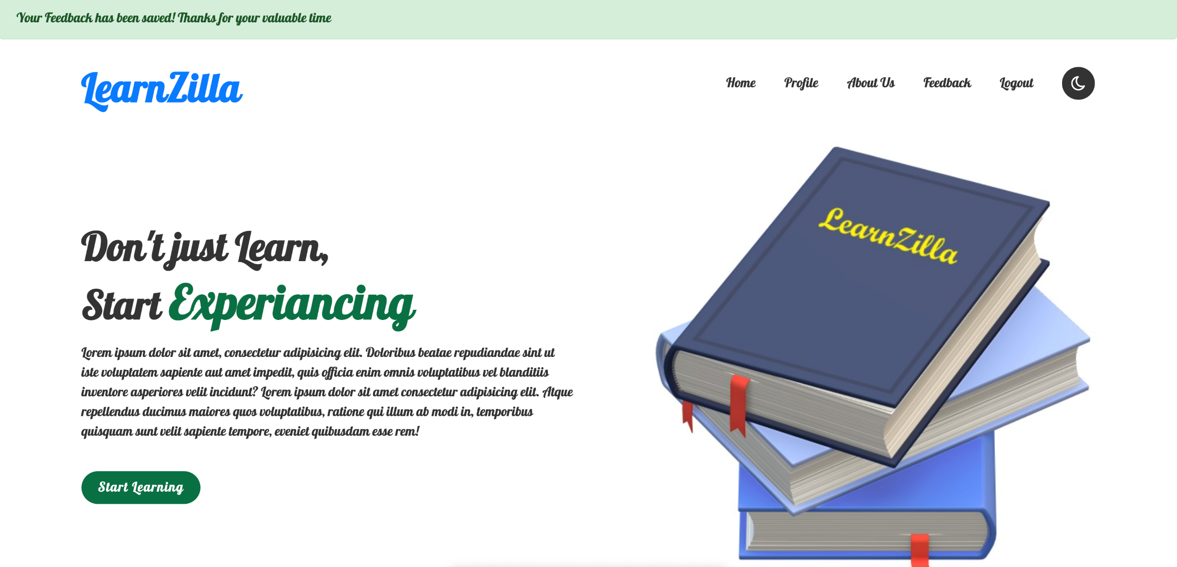
Feedback saved and sent to admin message

Slide 45
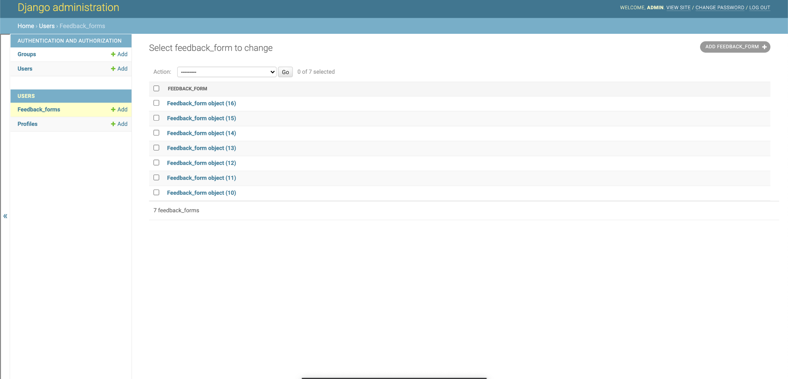

Slide 46
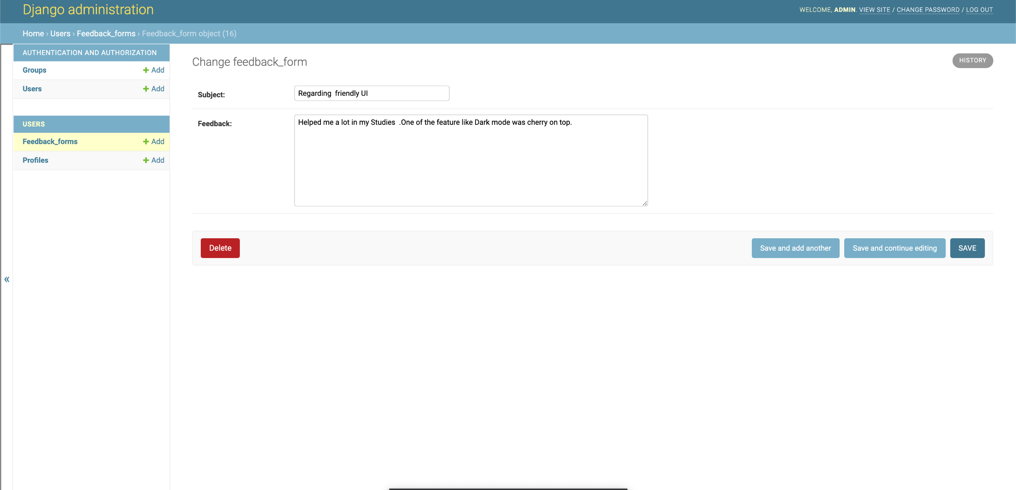

Slide 47
Conclusion
Our project is only a humble venture to manage our project work. To design a clean portal with easy to access user-interface. An e-learning portal in which the user will be able to access content from various web-sites, having the freedom to choose from what is more comprehensible to them.
At the end it is concluded we have made effort on following points
Made statement of the aims and objective of the project.
We included features and operations in detail, including screen layouts.
We designed user interface and security issues related to the system.
Finally the system is implemented and tested according to the test cases.

Slide 48
Future Work
If we continued this project for 7th semester, we would like to host our own website.
We will add additional features such as a secure payment gateway
So we can provide additional content for our paying users.
Window for doubts – That will help teachers to clear doubts of students in a conversational manner.
Improved Testing system – We will try to opt for a system where teachers will be able to put up tests and also students will be able to submit responses.
Quiz – A system where we can provide with MCQ’s students can solve them and check the correct answers right after submitting their responses.

Slide 49
References
1) HTML5 W3C Recommendation 28 October 2014 (@ http://www.w3.org/TR/html5).
2) CSS3 Selectors module (@ http://www.w3.org/TR/selectors/); CSS3 Colors module (@ http://www.w3.org/TR/css3-color/).
3) MySQL 5.7 "Reference Manual" @ http://dev.mysql.com/doc/.
4)Django reference is from (@https://docs.djangoproject.com/en/3.2/ref/urls/#module-django.conf.urls).

